Slide 1
Scottish Medical Appraisers Conference
27 May 2021
Appraisal in the new world
Dr Krystyna Gruszecka: GP Appraiser | Course Tutor
Dr Hilary Macpherson: SC Appraisal Lead | Course Tutor
Notes:
[Audio transcription]
Welcome to the Medical Appraisal Scotland New Appraiser training. This is module 1, an overview of Medical Appraisal in Scotland.

Slide 2
Video 1
Where did it go wrong?
Comments please in “Discussion Forum”

Slide 3
Video 1
Please continue to post your thoughts

Slide 4
Tips for virtual appraisals (1/3)
Practicalities
Good internet connection
2 screens
Plugged in / plenty of charge

Slide 5
Tips for virtual appraisals (2/3)
Pre-planning
Send invitation several days ahead
Exchange telephone numbers as backup
Set-up
Avoid bright light or window behind you
Be aware of what is behind you
Avoid interruptions
Dress appropriately (at least what’s visible!)

Slide 6
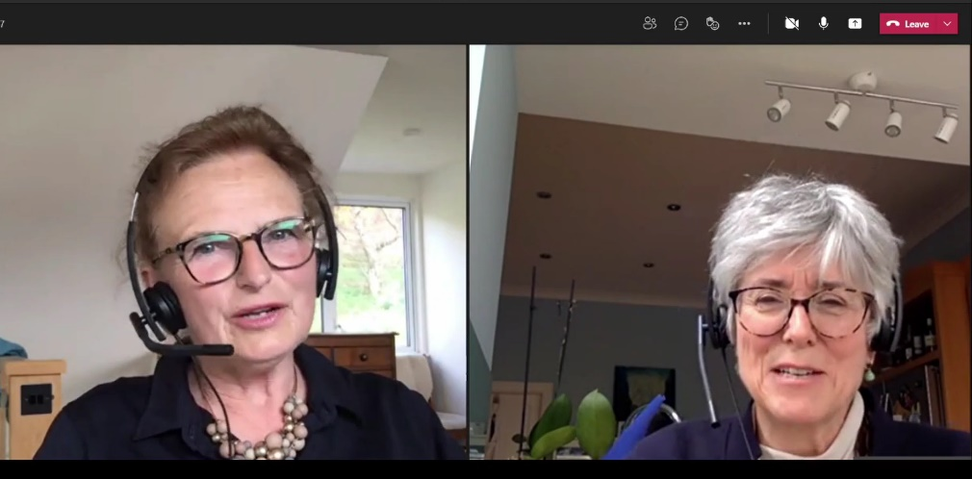
Tips for virtual appraisals (3/3)
Discussion
Intro chat to check all is working
Pay attention to visual and audio cues
Try to use facial cues for pacing
smiling nodding, facial expression
If needing to interrupt, try putting up hand
Be your usual self

Slide 7
Video 2
What went well?
What could have been done differently?
Please use “Discussion Forum” as things come to mind

Slide 8
Breakout room discussions
What well-being issues have you encountered?
What would give you more confidence with well-being appraisals?
What resources have you found useful?
Nominate one person per group to feedback via Discussion Forum

Slide 9
Scottish Medical Appraisers Conference
27 May 2021
Feedback from breakout discussions
Notes:
[Audio transcription]
Welcome to the Medical Appraisal Scotland New Appraiser training. This is module 1, an overview of Medical Appraisal in Scotland.

Slide 10
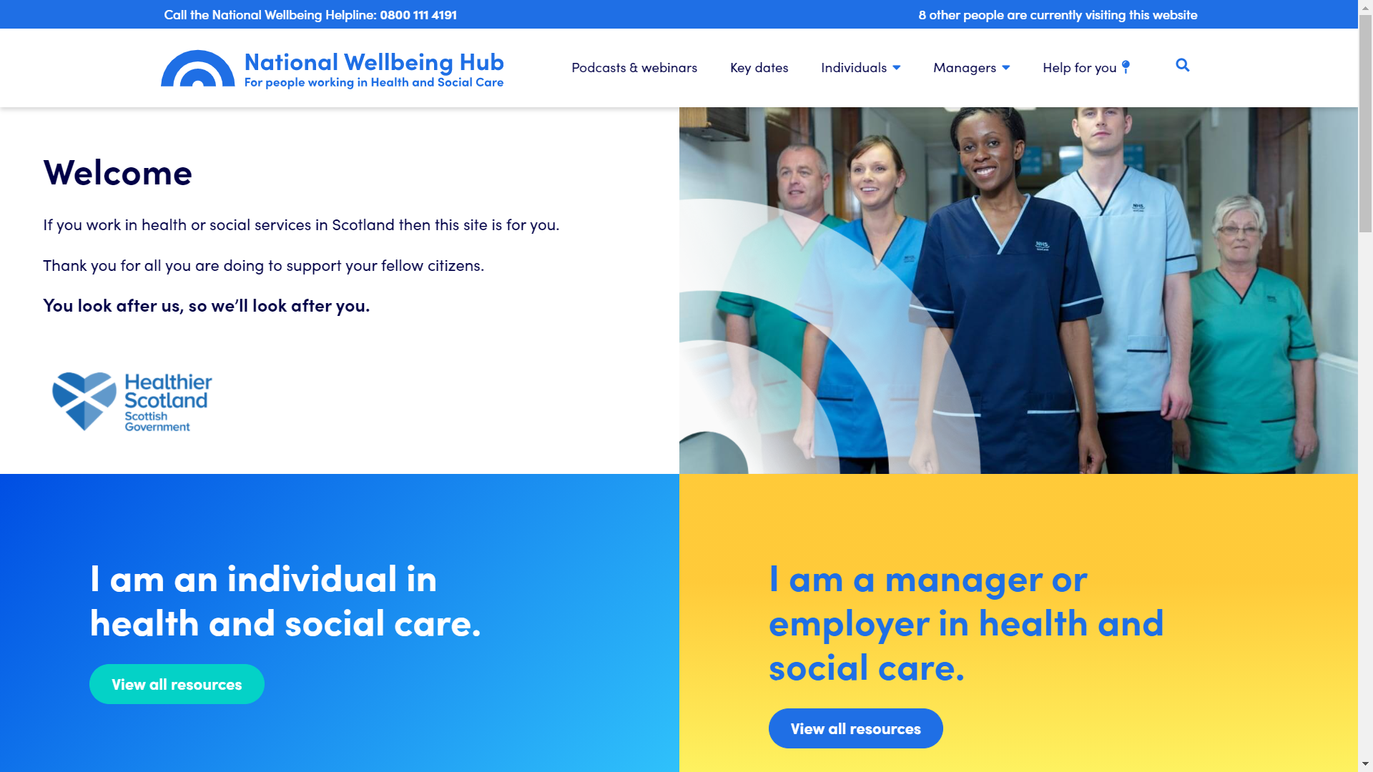
Self-help (1/2)
National Wellbeing Hub
Feeling Good
Sleepio
Daylight
Notes:
National Wellbeing Hub (https://www.nationalwellbeinghub.scot) - lots of useful advice and links and free access for NHS staff to apps such as Feeling Good, Sleepio, Daylight etc

Slide 11
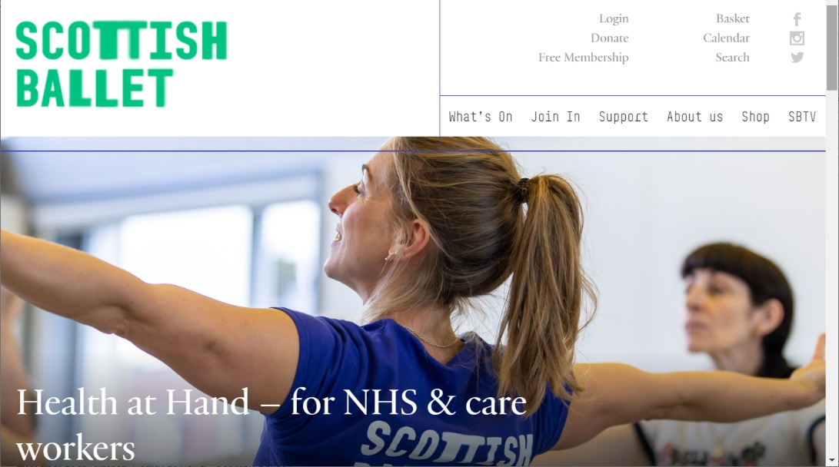
Self-help (2/2)
Exercise
Local classes
Health at Hand (Scottish Ballet)
Yoga / Hypnotherapy
Notes:
Exercise. Local classes, Health at Hand - Scottish Ballet (https://www.scottishballet.co.uk/health-at-hand)
Yoga, Hypnotherapy (many free classes for members of College of Medicine and Integrated Health)

Slide 12
Local and National mentoring schemes
Extra support
Local well-being Hubs
BASICS Scotland “wobble line”
Own GP
Occupational Health
BMA Counselling Service
Workforce Specialist Service
Notes:
Local and National mentoring schemes, Local well-being Hubs, BASICS Scotland “wobble line”, Own GP, Occupational Health
BMA Counselling Service ( offers counselling for family members as well as doctors)
Workforce Specialist Service (currently provided via NHS Practitioner Health) - can offer counselling, CBT, psychiatry support and even links to inpatient care in extreme circumstances)
Access via National Wellbeing Hub - go to help for me icon and quick links

Slide 13
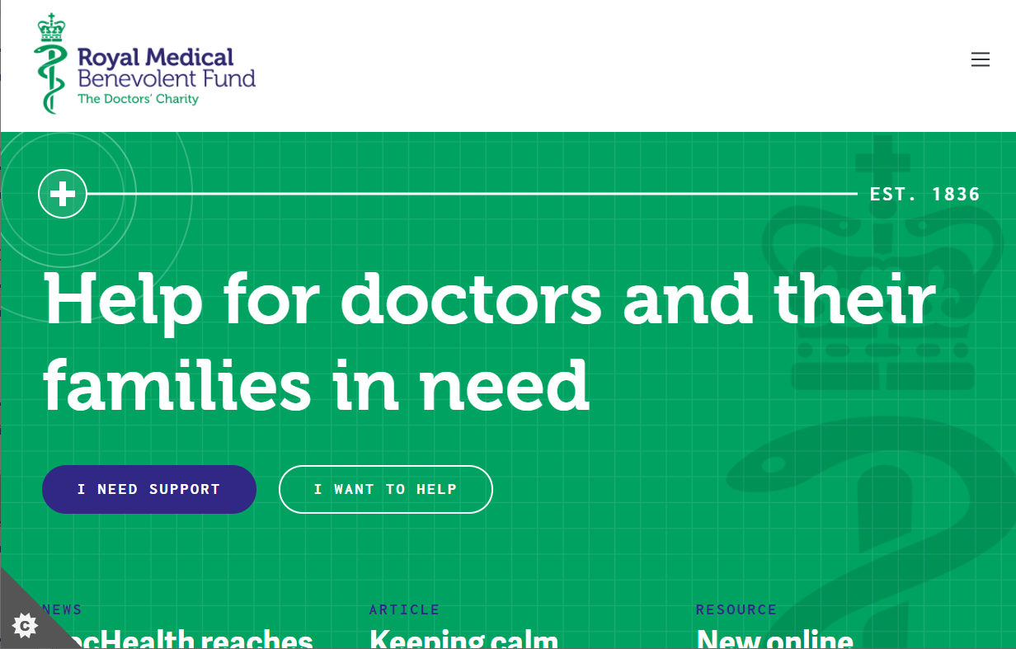
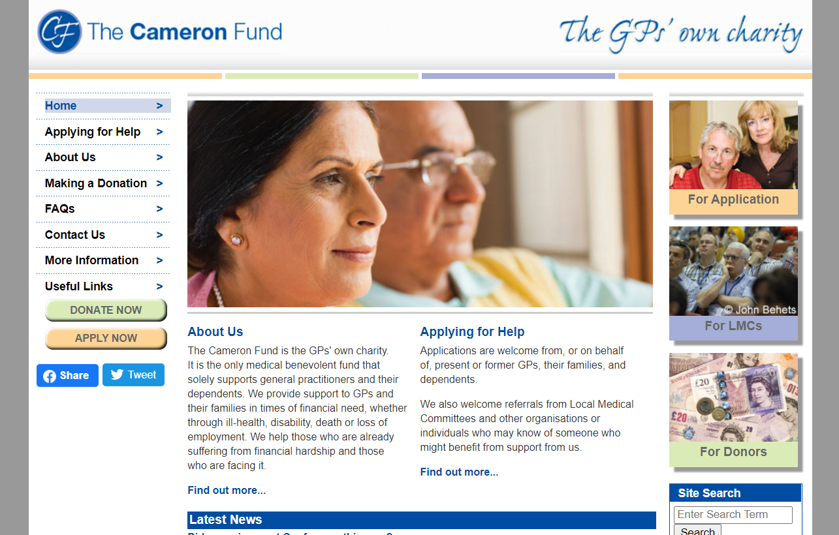
Charities
Royal Medical Benevolent Fund
Cameron Fund (for GPs)
Notes:
Royal Medical Benevolent Fund (https://rmbf.org)
The Cameron Fund (https://www.cameronfund.org.uk)

Slide 14
This Photo by Unknown Author is licensed under CC BY-NC-ND

