Slide 1
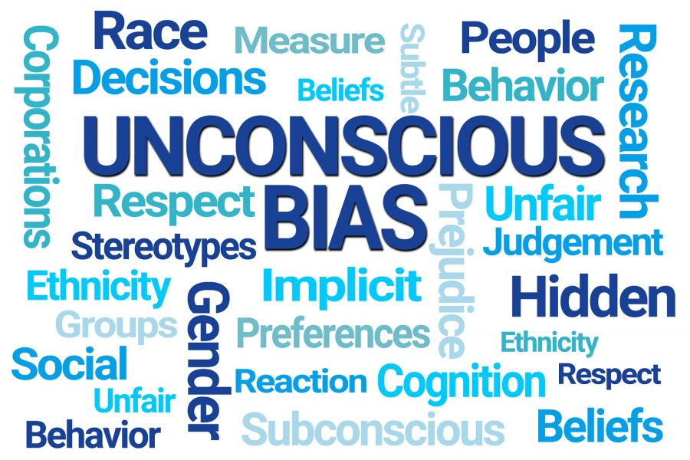
Dr Sneh Banik
Consultant Physician and Diversity Champion, NHSG
SFP Director, North Scotland
Liz Howarth
Engagement and Inclusion Manager, NHSG
Unconscious Bias and Active Bystander Session

Slide 2

Learning Outcomes
Understanding Unconscious Bias
Understanding Micro-behaviours
Recognise the impact of bias in the workplace
Understand the challenges around bystander interventions
Identify strategies for successful bystander interventions

Slide 3
Scenario discussion…
A father and son are in a horrible car crash that kills the dad.
The son is rushed to the hospital for emergency life saving surgery
Just as he’s about to go under the knife, the surgeon says, “I can’t operate—that boy is my son!”

Slide 4
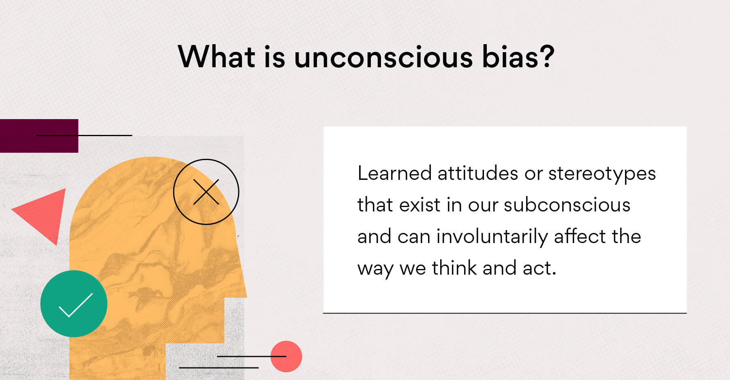
Notes:
Explain why biases exist- mental shortcuts that can have gross general benefits but also cause significant issue if unchecked
factor towards differential attainment

Slide 5


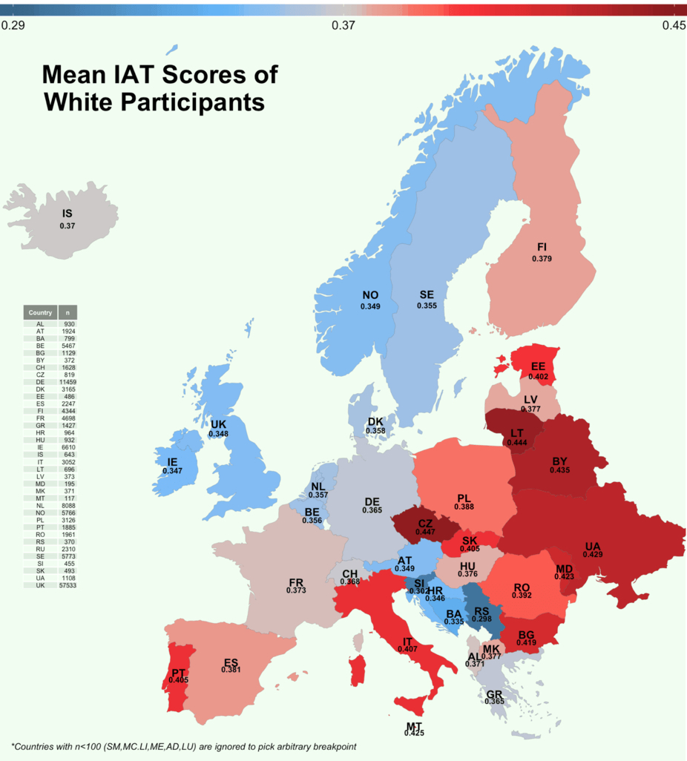
Project Implicit
5 Million Participants showed Pro White bias
70% of White Participants showed
Pro-White Bias
50% of Black Participants showed
Pro-White Bias
Notes:
Pause
Project Implicit was set up in 1998 by three scientists – Dr. Tony Greenwald, Dr. Mahzarin Banaji, and Dr. Brian Nosek. There is a series of different association tests on the website and from this data it’s produces high-impact research that forms the basis of our scientific knowledge about bias and disparities.
Race Bias test it showed that from the 5 millions participants there pro-white bias. In whites that completed that the test this was shown in 70%. In Blacks this shown in 50%.
Ask audience of anyone has completed the IAT? Are they willing to share their results?

Slide 6
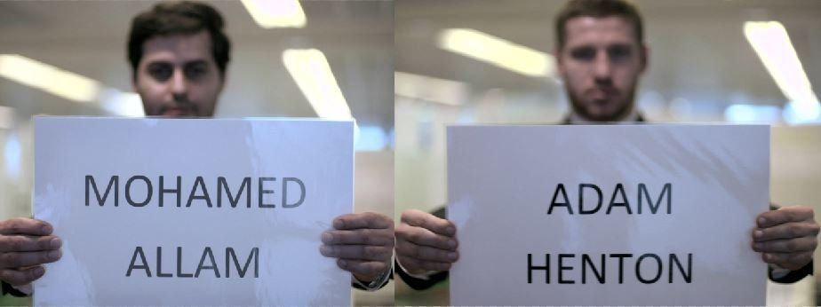
Bias
Notes:
A job seeker with an English-sounding name was offered three times the number of interviews than an applicant with a Muslim name, a BBC test found.
Inside Out London sent CVs from two candidates, "Adam" and "Mohamed", who had identical skills and experience, in response to 100 job opportunities.
Adam was offered 12 interviews, while Mohamed was offered four.
Although the results were based on a small sample size, they tally with the findings of previous academic studies.
Sne/Amir/Joy- to give anecdote of when they have felt bias

Slide 7
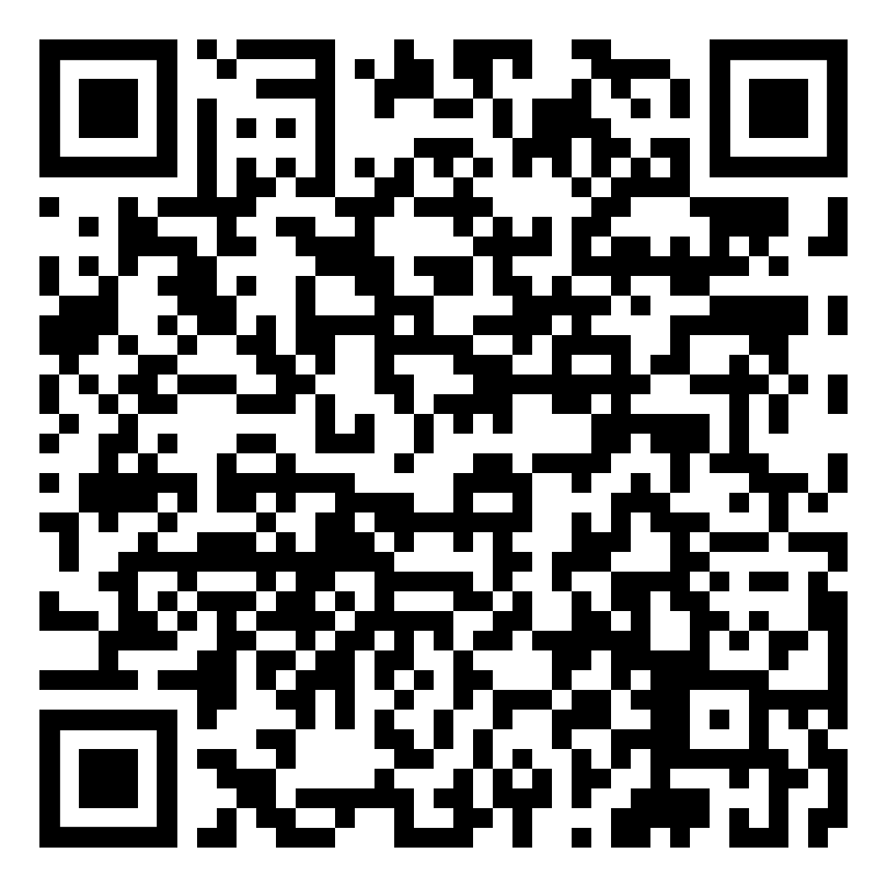
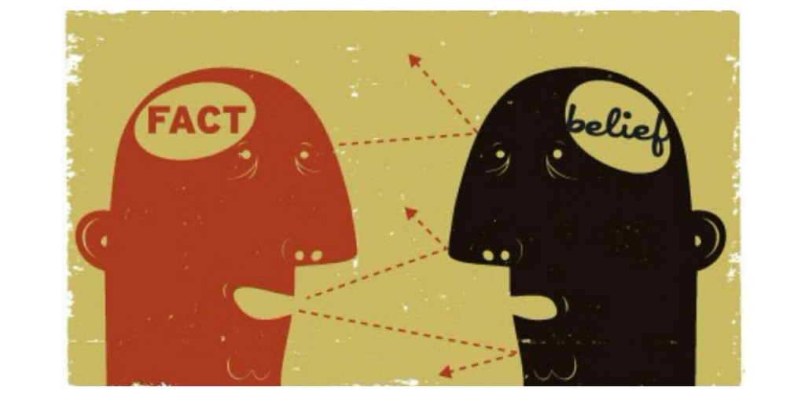
Group Discussion
What bias do you have?

Slide 8
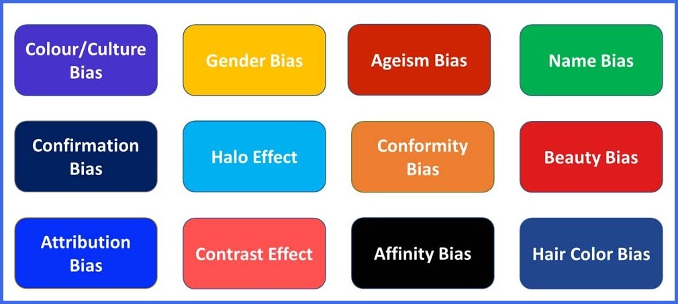
Notes:
Various forms of BIAS
Ask audience if they recognise the listed biases?
Can they give examples of them?
Have they experienced them?
How

Slide 9
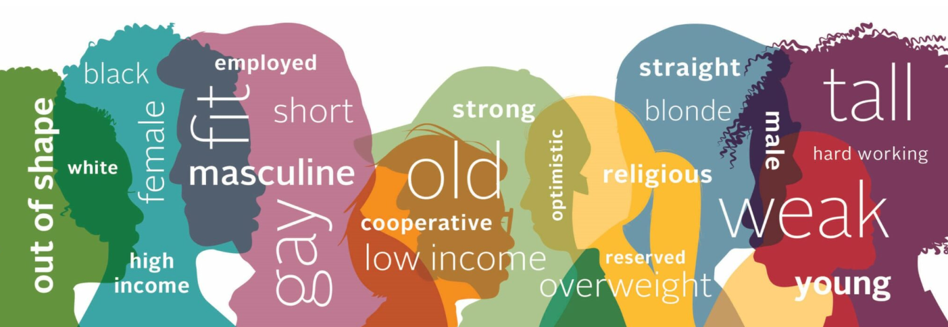
Group Discussion
Thinking as an appraiser, what are some of the key situations when you would have to really
‘check your bias’?

Slide 10

Video clip

Slide 11
Microaggressions
Notes:
These videos are examples of microaggressions

Slide 12
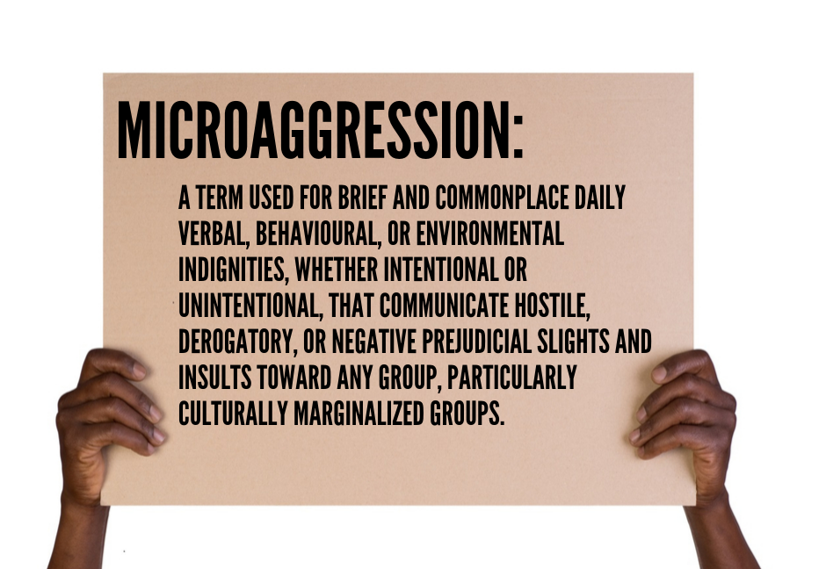
Notes:
American psychiatrist Chester M. Pierce invented the word "microaggression" in the 1970s to describe insulting moments for black people.
The term has since been developed further to include other groups which may be marginalised in other situations, including other BAME people and members of the LGBT community.
Often these incidents are the result of unconscious bias - when one person has a pre-conceived idea about who people in another group are or how they should behave.
So a white person may be surprised when a black person doesn't speak with a certain accent, or wear certain clothes, and may voice that surprise.
The black person may feel that as a slight - as if the white person is telling them they don't belong.

Slide 13

Notes:
Microaggressions are more than just insults, insensitive comments, or poor behaviour.
A key part of what makes them so disconcerting is that they happen casually, frequently, and often without any harm intended, in everyday life.
Research shows that microaggressions can take a real psychological toll on the mental health of their recipients.
Sne/Amir/Joy- give anecdotes re micro aggressions they have experienced.
Do audience have any micro-aggressions that they wish to share?
Ask audience why they think these topics relevant in trainer/trainee
Questions

Slide 14

Pre-session Confidence Check-in
If you were to witness bullying and harassment in the workplace, how confident would you be to stage a successful intervention?

Slide 15
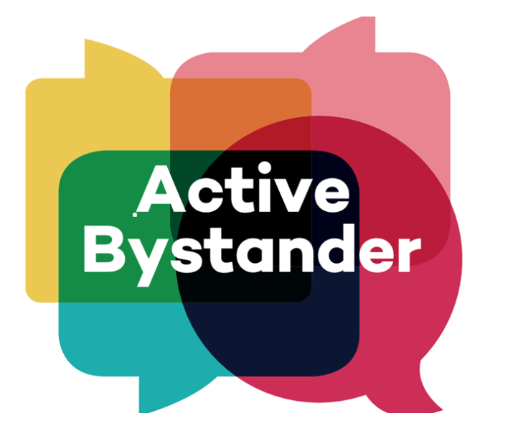
Group Discussion
What are the barriers to bystander intervention?

Slide 16
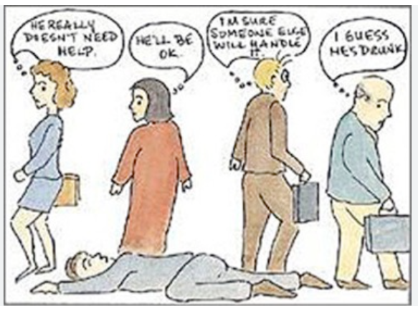
Reasons for not intervening?
Assuming that ‘someone else’ will intervene
Thinking ‘I don’t know the person it’s happening to – don’t get involved’
Being concerned about other people negatively appraising their intervention
Fear of retaliation: e.g. physical harm, or others’ reactions, at the time or afterward
Incorrectly believing their views are in a minority ‘nobody else thinks this behaviour is wrong, they aren’t saying anything’
Hesitation in the moment, not being able to make sense of what is happening

Slide 17
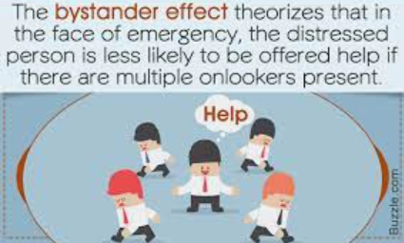
The bystander effect

Slide 18
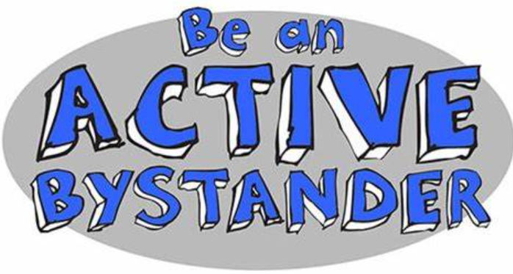
How to be an active bystander
Notice – be awake to your surroundings
Interpret – do I recognise that someone needs help
Feel empowered – recognise that it is your responsibility to help
Know – how to act, educate yourself on strategies to be proactive
Intervene – take action but be sure to take care of yourself

Slide 19
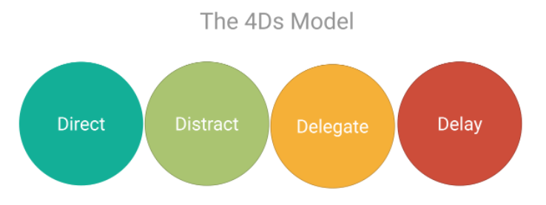
4Ds - Strategies for bystander intervention
Direct – step in and intervene
Distract – draw attention away from the situation
Delegate – call for help
Delay – If you are unsure, but checking in with the person and acknowledging that the situation wasn’t ok

Slide 20

Delay
Delaying doesn’t mean doing nothing
Report to relevant authorities
Record witness statements
Create bystander allies
Check in with the person afterwards

Slide 21
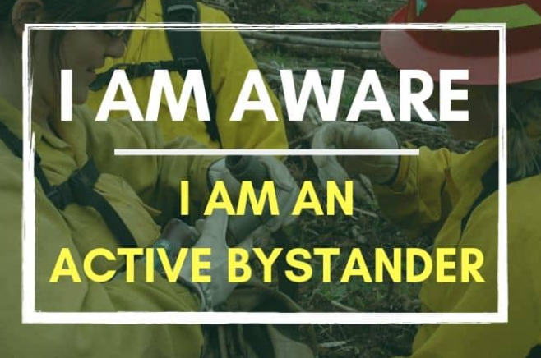
Strategies for Direct Intervention
Use ‘I’ Statements
Silent stare/ body language
Use social norms
Group intervention
Bring it home
Call on friendship
Remember: the Golden Rule is only intervene directly if it is safe to do so
Notes:
There are a number of recognised strategies** that can help:
Use ‘I’ Statements:
Change the focus to yourself: 1) State your feelings, 2) Name the behaviour, 3) State how you want the person to respond. This avoids criticising the other person, and helps to prevent escalation for example:
“I don’t like racist jokes. It makes me feel uncomfortable, please don’t make them in future
“I didn’t like what you said about those women. I don’t feel it’s appropriate, please don’t use that language in future.
Silent stare/ using body language:
You don’t have to speak to communicate. Sometimes a disapproving look or not smiling at a ‘joke’ can be far more powerful than words.
Use social norms:
Identify that this is not usual or accepted behaviour, for example
“Most people I know don’t think it’s OK to….” or “People just don’t say that kind of thing anymore…”
Group intervention:
There is safety and power in numbers.
Best used with someone who has a clear pattern of inappropriate behaviour where many examples can be presented as evidence of their problem, either to them or a senior colleague/staff member.
Bring it home:
Engage empathy with the person behaving inappropriately, for example
“I hope no one ever talks about you like that” or “How would you feel if someone did that to you/your sister/your daughter?” or “I wonder if you realise how that comes across?”
Call on friendship:
Reframe the intervention as caring, for example
“Alex, as your friend, I’ve got to tell you that lots of people don’t like your jokes about XYZ; it annoys them” or “I know that you would not want to offend someone but using that word is not great’.

Slide 22
Post-session Confidence Check-in
If you were to witness bullying and harassment in the workplace, how confident would you be to stage a successful intervention?

Slide 23

Upstanders are pretty awesome people
Courageous: Intervening when someone is demonstrating bullying behaviours is hard, especially when there is hierarchy.
Action-orientated: Doing something to discourage the bullying behaviour could be a really small intervention with big results! Highlighting bullying behaviour will often cause others to recognize the problem.
Assertive: Telling someone how their behaviour makes you feel and how it affects others requires you to use your voice and speak up.
Compassionate: Upstanders have the gift of compassion. They recognize when someone is hurt and take steps to help.
Leaders Upstanders are leaders in their social group, helping others to recognize ways to get along and be supportive to others.

Slide 24

What next…..
gram.staffequalities@nhs.scot

