Slide 1
Appraisal and Coaching
Iain Wallace

Slide 2
Mentors, Counsellors, Coaches, Priests and Friends

Slide 3
Coaching

Slide 4
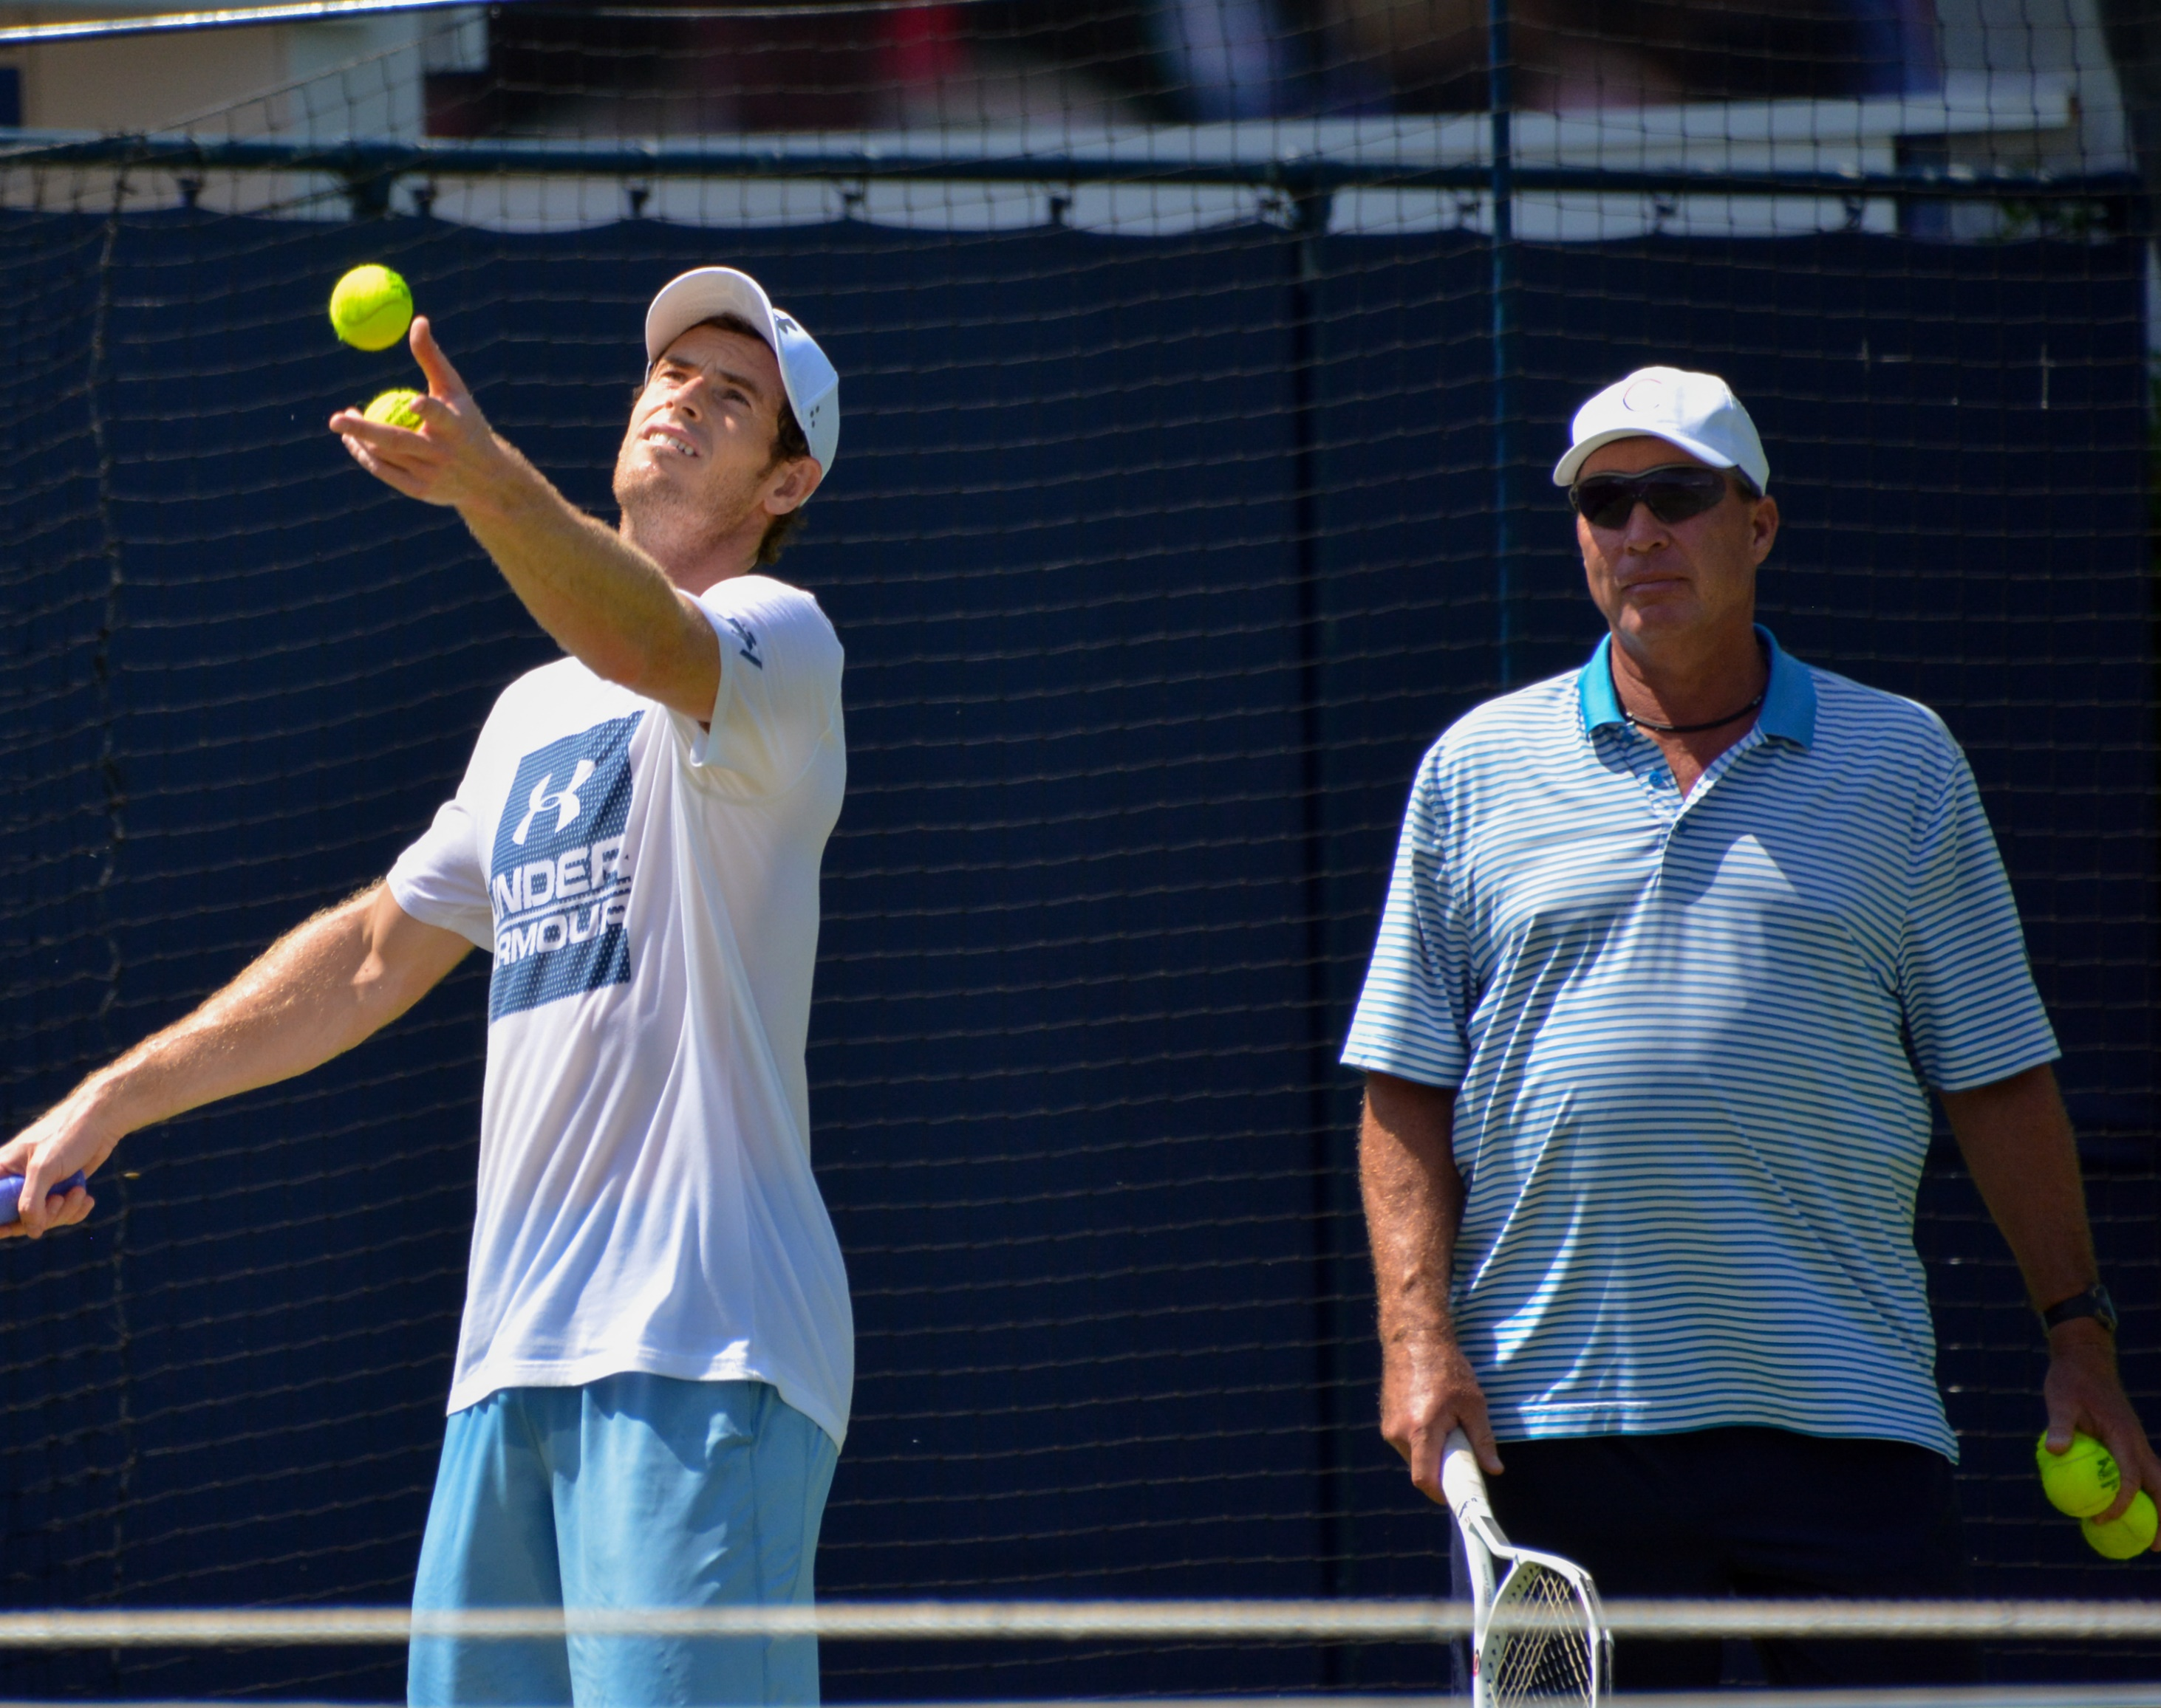
‘Helping them learn rather than teaching them’
(Gallwey, T. 1986)
This Photo by Unknown Author is licensed under CC BY-SA

Slide 5
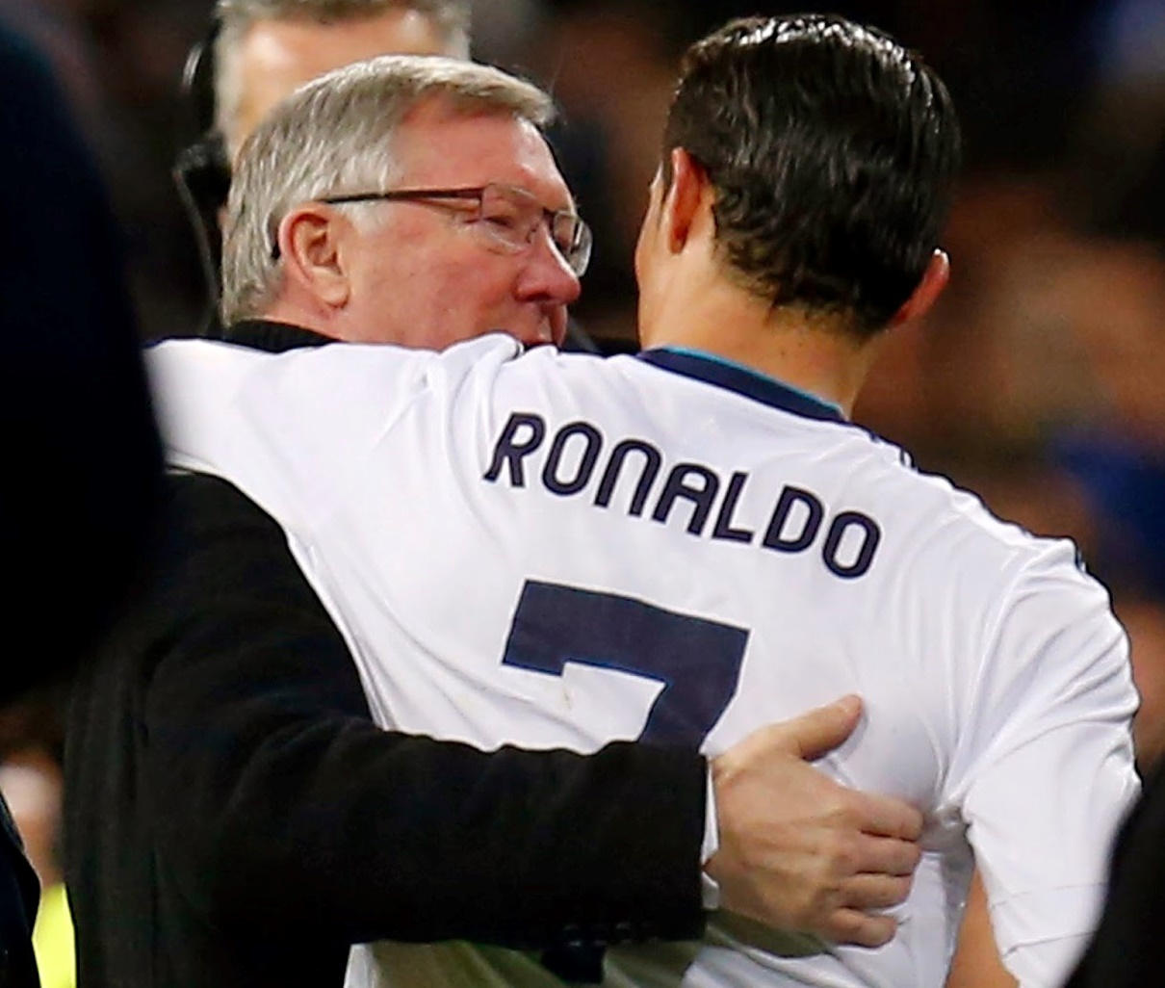
‘Unlocking a person’s potential to maximize their own performance’
(Whitmore, J., 2002)
This Photo by Unknown Author is licensed under CC BY-SA-NC

Slide 6
Assisting a client to bridge the gap between where they are now and where they would like to be far more effectively than if they worked alone
This Photo by Unknown Author is licensed under CC BY-SA-NC

Slide 7
A one-to-one conversation focused on the enhancement of learning and development through increasing self-awareness and a sense of personal responsibility, where the coach facilitates the self-directed learning of the coachee through questioning, active listening and appropriate challenge in a supportive and encouraging climate.
Growth Coaching International

Slide 8
Coaching can achieve this by:
Helping to raise the awareness of a client with effective questioning techniques
Assisting them to create practical, step-by-step action plans to reach their goals
Providing on-going support through any changes or obstacles
Providing a client with tools, techniques and strategies to create lasting change and success

Slide 9
Coaching in action
People are naturally creative and resourceful
They are capable rather than dependent and fragile
Focus is on the whole person
Even if there is a ‘problem’ to solve, there is often more behind this.
No topic exists in isolation
Utilise heart, mind and gut feeling

Slide 10
Personal chemistry is important

Slide 11
Appraisal and coaching…. what’s the connection?

Slide 12
Both….
are formative
focus on the individual
facilitate self-reflection and self-awareness
support personal development and how an individual contributes to their team and organisation
help people figure out what their goals are and how they might go about achieving them

Slide 13
Competencies of a coach
Self-awareness
Being curious
Ability to raise awareness in others about their:
Assumptions
Beliefs
Attitudes
Repeating patterns
Blindspots

Slide 14
Coaching skills
Being ‘present’ – giving focused attention/listening
Open questioning
Exploring metaphors
Using creativity to problem solve
Providing feedback
Careful challenge
Being clear about scope and boundaries

Slide 15
Example 1

Slide 16
Levels of listening
Level I
Internal – what does this mean for me?
Level II
Dialogue – focus all on the client and what they are saying. Sense of connection/empathy.

Slide 17
Level III – global listening
Content
What is said
How it’s said
What’s not being said
How it’s felt by the coach
Tone
Mood/Energy

Slide 18
Coaching techniques
Encouraging
Show you are listening – yes, uh-huh, non-verbals
Extending
‘Tell me more…’
‘What else?’
Reflecting back what you hear
‘So what I am hearing is….’
Reflecting what you see and feel
‘As you say that, I notice….’
Summarising
‘You have mentioned x things. The first etc’

Slide 19
Example 2

Slide 20
Good coaching questions
Can you tell me more?
What will happen if you don’t do it?
Where are you drawn to now?
What would you like to ask yourself about being here?
What’s standing in your way?
What does success look like?
What are you doing to not achieve this?

Slide 21
What about the coachee?
Response- ability
It’s their choice whether to change or not – coaching simply creates space
Watch out for
Blame
Collusion
Stuck patterns – energy of resistance

Slide 22
Resistance
‘The greatest barrier is the inability to give up what you have done before’
John Whitmore

Slide 23
Resistance
During their life people develop habits to help them cope with different situations
These habits serve a purpose but once hard wired they can be difficult to ‘unwire’
Habits are often a ‘comfort blanket’
People often fall back on them even when they don’t serve them well
The coach's job is to support self-awareness and help their client develop new habits that better serve them in their current state

Slide 24
Two popular coaching models
GROW
Solutions focus/OSKAR

Slide 25
GROW
Goals – ‘What would you like to achieve?’
Reality – the coachee’s world in their words
Options – open up before closing down
Will – ‘What will you do now?’

Slide 26
Solutions focus (OSKAR)
Outcome – ‘What would success look like to you?’
Scaling – ‘What level are you at just now?’
Know how – ‘Who could help you with that?’
Affirm and action – ‘What steps can you take today?’
Review – ‘What did you do that made the change happen?’

Slide 27
Getting unstuck
Using objects in the room
Coaching cards
Chair work
Imagining a timeline

Slide 28
Example 3

Slide 29
How might you apply these coaching approaches during appraisal?

Slide 30
Coaching within appraisal - what might get in the road?
Lack of confidence in applying a coaching approach
Limited time available
Appraisee sceptical
Appraisee lacking in self-awareness
Anything else?

Slide 31
Some quick questions

Slide 32
Is coaching an approach you already use when appraising someone?

Slide 33
Should coaching be a core skill that appraisers have?

Slide 34
Have you had any training in coaching?

Slide 35
Would you consider training as a coach?

Slide 36
Breakout discussion
Is there a place for coaching in appraisal?
Would you be more comfortable using a coaching approach after today’s webinar?
Is there anything else that you need to make you more confident in using this approach?

Slide 37
Further reading
The Tao of Coaching – Max Linsberg
101 Coaching Strategies and Techniques – Gladeana McMahon and Anne Archer
Coaching for Performance – John Whitmore
The solutions focus – Paul Z Jackson and Mark McKergow
Co-active coaching – Henry Kimsey-House et al
Gestalt Coaching – Peter Bluckert
NES Coaching and Mentoring Info pack – NES Turas Learn (click on link)

