Slide 1
Surgical management of otitis media with effusion in children: A rolling audit in the ENT Unit in XXXX

Slide 2
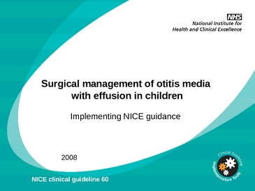
Objective
To evaluate how well we are adhering to national guidelines (CG60: Surgical management of OME, Feb 2008); specifically do our paediatric patients meet the criteria for surgery

Slide 3
Local guidelines adapted from National NICE guideline
In cases of OME
≥ 3/12 of watchful waiting
≥ 25db of conductive hearing loss in better ear
Alternatives to surgery discussed
In cases of recurrent AOM
≥4 episodes in 6 months
Alternatives to surgery discussed

Slide 4
Methods
Retrospective review of the clinical notes at pre-admission by SHOs conducted from 20/09/2013 to 10/01/2013.
Pre-existing proforma listing the NICE criteria completed for each child listed for bilateral insertion of grommets for bilateral OME.
Completed forms then reviewed by ER and checked against clinical letters on clinical portal and adherence and non adherence recorded with details of latter cases obtained.

Slide 5
Results (1)
In ~3/12 there were 21 cases of children having bilateral insertion of grommets

Slide 6
Results 2

Slide 7
Results 3

Slide 8
Results (4)
1 case of non adherence: Patient reported 6/12 hx of hearing loss and had a bilateral conductive hearing loss on audiometry and was listed for surgery on that first OPC appt; No 3/12 of watchful waiting. (?discussion of surg)
1st case with mitigating circumstances: Patient presented with a history of poor language development. No 3/12 of watchful waiting or formal audiometry.
2nd case with mitigating circumstances: Patient had normal audiogram, but family history of mastoiditis, recurrent episodes of AOM (not quantified)

Slide 9
Conclusions
Low incidence of non adherence to guidelines (~5%)
Would completing existing proforma at time of listing patients help improve this or needlessly generate more paper-work in what are already busy clinics?
Observations made during audit:
Documentation of discussion regarding alternatives to surgery not always clear.
Quantification of cases of AOM often not stated.

