Slide 1
Resilience Issues
Appraisal Conference May 2017
Alison Garvie and Linsey Semple

Slide 2
Aims of the session
To identify early warning signs
To consider underlying causes
To consider how to support a doctor with poor resilience
To look at strategies and resources which might help

Slide 3
What are we trying to do?
Help appraisees:
deal with uncertainty
deal with complexity
avoid feeling overwhelmed

Slide 4
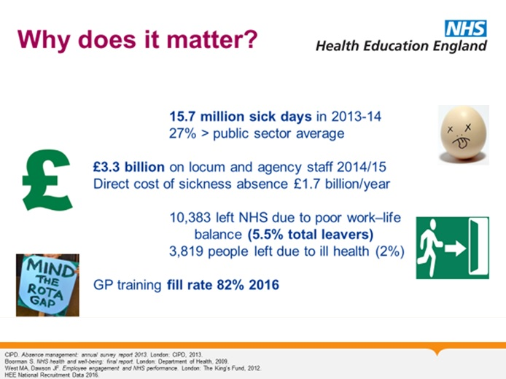
Why is it an issue?

Slide 5
What is Resilience?
The ability of an individual to adjust to adversity, maintain equilibrium, retain some sense of control over their environment, and continue to move on in a positive manner Jackson et al 2007
Can be learnt
“Do not judge me by my successes, judge me by how many times I fall down and get back up again” Nelson Mandela

Slide 6
Attributes of a resilient person
Accepts there are challenges in life
Adapts more quickly to change
High frustration tolerance
Realistically optimistic
A sense of humour
Sense of perspective
Low anxiety
Self acceptance
Self belief
Altruism

Slide 7
How does personality affect resilience?

Slide 9
How does personality affect resilience?
How do changing circumstances affect people’s ability to cope?

Slide 10
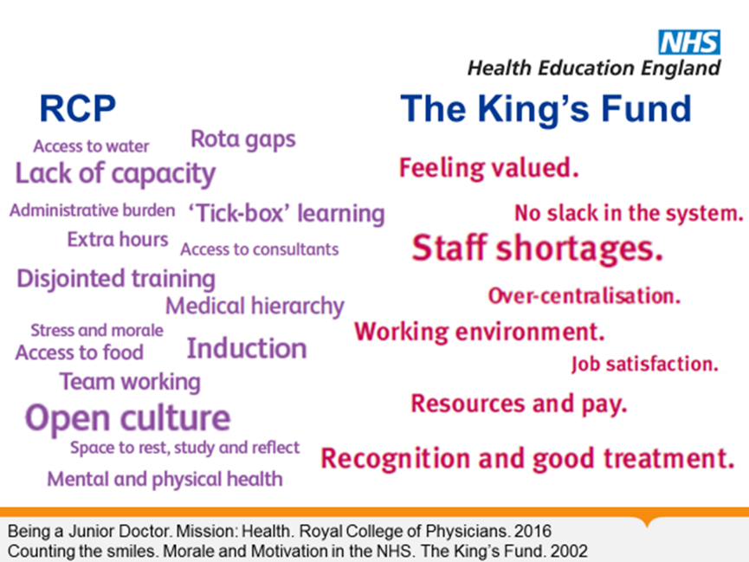

Slide 11
Personality traits v State
Set by age 30 changes – effect of being
overworked/relaxed?
Conscientiousness
Neuroticism
Extraversion
Agreeableness
Open to experience

Slide 12
Perfectionism
Healthy –useful, driver of high quality care
Unhealthy – dysfunctional, for individual, team and patients
Cultural and societal issues – Generation Snowflake??
Perfectionism is a common trait in doctors with resilience problems

Slide 13
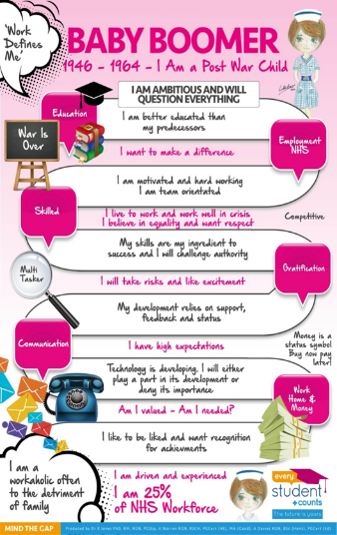
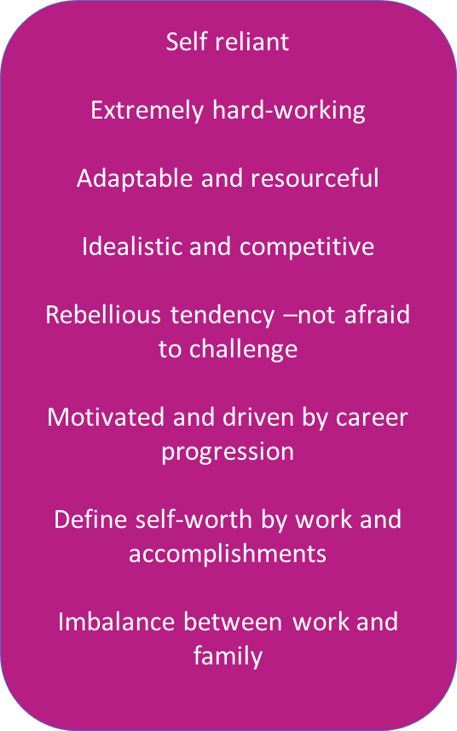

Slide 14
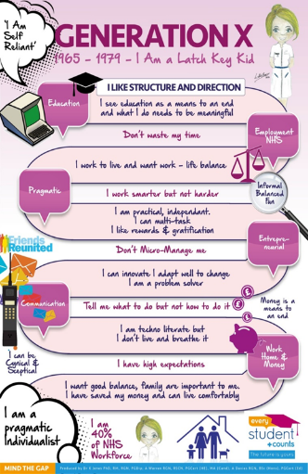
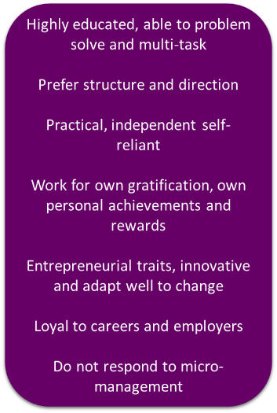

Slide 15

Gen Y
1980-1994 (21-35yrs old)
Ambitious
Career-motivated- expect support to achieve
Less bound to role or employer
Are less motivated by money than purpose
Mission driven- want sense of accomplishment
Feedback
Recognition
(Team-player)
Taught to question everything
Hard-working
Family orientated
Career, but not at any cost
Like to be loved
Valued
Recognised
Reputation important
Work with you- not for you
Nurtured

Slide 16
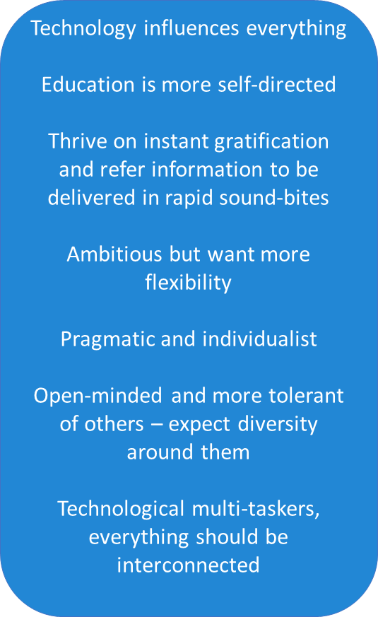
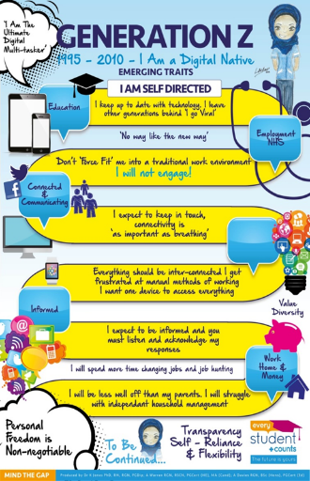

Slide 17
Healthy v Unhealthy Perfectionist doctors
Discuss in groups

Slide 18
Early Warning Signs that a doctor is not resilient

Slide 19
Healthy v Unhealthy
Efficient
Thorough
Organised
Good time Mx
Challenging
In control
Up to date
Stimulates others
Keeps at work
Has insight
Inefficient
Rigid
Overwhelmed
Poor time Mx
Increases others workload
Stresses colleagues
Unable to make decisions
Off sick
No insight

Slide 20
Early warning signs
Poor time management
Procrastination
Avoidance
Copes badly with perceived negative feedback
Poor team working
Excessive delegation

Slide 21
Reactions to the stress of being a doctor
Survival personality
The “seven signs”
Burnout
Medical narcissism

Slide 22
Survival personality
“…many develop a psychological strategy to cope by shutting off the parts of themselves that would otherwise find some aspects of the work unbearable. This “survival personality” allows them to function well in the work setting, but at a cost to other parts of their life. This process is seen in other settings too – the military in combat, and staff in long term institutions, for example.”

Slide 23
Seven key early warning signs
The “disappearing act”
Low work rate
“Ward rage”
Rigidity
“Bypass syndrome”
Career problems
Insight failure

Slide 24
Burnout
Emotional exhaustion – characterised by a feeling of emptiness and emotional blunting
Depersonalisation – cynical attitude and negativity
Reduced personal accomplishment – doubts about personal and professional effectiveness

Slide 25
Medical Narcissism
Term devised by John Banja in Medical Errors and Medical Narcissism
It suggest that medical narcissism helps physicians do their difficult work
Medical narcissists may find the disclosure of an error to be too much of a challenge to their self image of competence, control and “treatment orientated focus”. They therefore have a tendency to rationalise the error as unavoidable, unimportant, or unnecessary to reveal because it will not change the outcome

Slide 26
Common reasons for lack of resilience

Slide 27
Common reasons for lack of resilience
Mismatch in values – perfectionist++
Feeling unsupported/ dysfunctional workplace
Fear of failure/ mistakes
Lack of control
Unclear job expectations
Poor job fit
External factors-lack of social support/ work-life
Underlying health issues

Slide 28
Anything in CV/ personal history which might be relevant?

Slide 29
Work/ Life experience
Part time training
Protected workload in past posts
Family
Expectations of what job is about?
External problems/pressures

Slide 30
Group work
Discuss your case

Slide 31
Role of the Appraiser
Listen
Identify warning signs early
Clarify what the specific problem is and help identify causes
Recognise sick doctor
Provide an “external” view
Signpost to other resources
Promote resilience with structured learning/support

Slide 32
Begin with the end in mind…
Encourage the appraisee to be pro active – what do they want to be doing in 1/5/10 years?
Is it realistic? SMART?
You might have to negotiate a different end point to make it achievable.
Can they put this in their PDP?
Do they need help from others to achieve this?
Do they need Career advice?
Are they well?

Slide 33
Enhancing Wellbeing – questions for the appraisee to ask themselves
What is my core purpose?
What could I change, what do I need to stop or reduce?
What needs to develop and grow?
What am I going to practice regularly to help these changes happen?
What would help me achieve this?

Slide 34
The Way Forward
Supportive working environment
Graded challenges
Provide support
Reflective practice/ self monitoring
Work/ life balance – more exercise
Mindfulness
Time management

Slide 35
Useful Techniques for the Appraiser

Slide 36
Useful techniques to use
Use of ICE (ideas, concerns, expectations)
Discomfort log
CV review/ review of current post/ external factors
Feedback skills/ encourage appraisee to reflect
MSF/PSQ
RCAs (GP)
Discussing SEAs
Auditing workload

Slide 37
Useful Techniques to use
The Wheel of Life
Refer to a mentoring scheme- RCP, RCGP, PSU for trainees, CDs, DME.
Encourage sharing difficult cases with colleagues e.g. MDTs
Encourage safety netting
Discuss referrals/ MMRs
Review teamworking
Experiential learning for less experienced appraisees e.g. non training grades

Slide 38
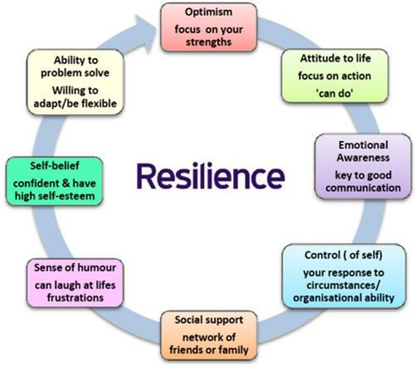

Slide 39
Problem areas
Role of appraiser- degree of support you can provide
Patient safety issues- when to escalate- issues of confidentiality
Ability of systems to adjust workload
Loss of face if appraisee seen to not be coping
How do you get appraisee to increase ability to cope?

Slide 42
Useful contacts
Royal Benevolent Fund –http://www.rmbf.org/pages/the-vital-signs.html
GMC confidential helpline 01619236 399
Resilience Insight information jenny.campbell@lifetimeswork.com
BMA.org.uk – counselling services

Slide 43
Reading materials
Blackbox Thinking- Matthew Syed
The Chimp Paradox – Steve Peters
e.g Better - Atal Gawande
A Country Doctor’s Notebook – Mikhail Bulgakov

