Slide 1

Electronic Patient Feedback
The Glasgow Secondary Care Perspective
Andrew Harvey
Una Graham

Slide 2
Background
Patient feedback well established
Majority using CARE via optical reader
  Approx 600 reports issued PA
Few problems encountered

Slide 3
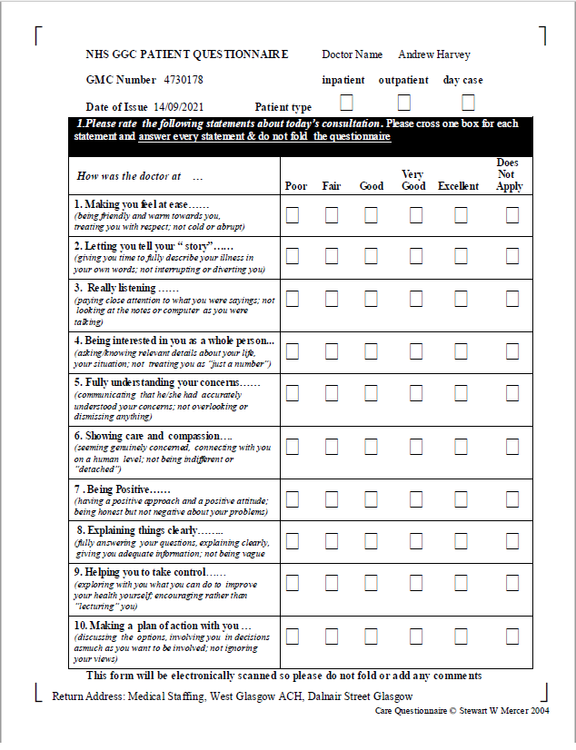

Slide 4
2019-20
Optical reader broke down
  Costly to fix
Covid
  New ways of working for everyone
  Certain doctor groups disadvantaged

Slide 5
Covid recovery - problems
Appraisal /revalidation reintroduced
  Large backlog to clear
Patient feedback deemed essential by GMC
  Misinformation spread amongst certain specialties
  Feedback numbers reduced
No agreement with optical company
Unsustainable workload for Medical Staffing

Slide 6
Solutions Sought 2021/22
Scottish Appraisal Leads Network
  Asked around
Copy primary care?
  External company
    No budget
    Doctors won’t pay
Bespoke solution?
  Well established eHealth service in GGC
  Contact made June 22

Slide 7
Discussion with GGC eHealth
– June 22
Instruction that internal solution to be explored prior to external
Issues spelled out
Must have/essentials identified
Solution proposed July 22
Out to pilot Late 22

Slide 8
Pilot of ePQ
Approved at Board Wide Revalidation group, Secondary Care Appraisal Group and Appraisal Leads meetings
Pilot commenced November 22 for 6 months
Prior to pilot discussion took place across the Board regarding test sectors -Sandyford – as demographic generally younger and text savvy
-MHS – as patient demographic mixed
choice of using one of 3 templates via the electronic system depending on specialty – the Standard Questionnaire, Radiology and Child Health

Slide 9
Process
A webropol individual package is created,with a link to the questionnaire emailed to their patients by a third party and also a QR code with a covering email. The QR code can be emailed to patients or via hard copy
The doctor is also sent a link to access their patient feedback results progress at any time via a password to access their results report
Results can be downloaded into Powerpoint, Excel, CSV, PDF, Word, PSS Format
Participants can use a mixture of electronic and hard copy questionnaires and results merged providing one overall report

Slide 10
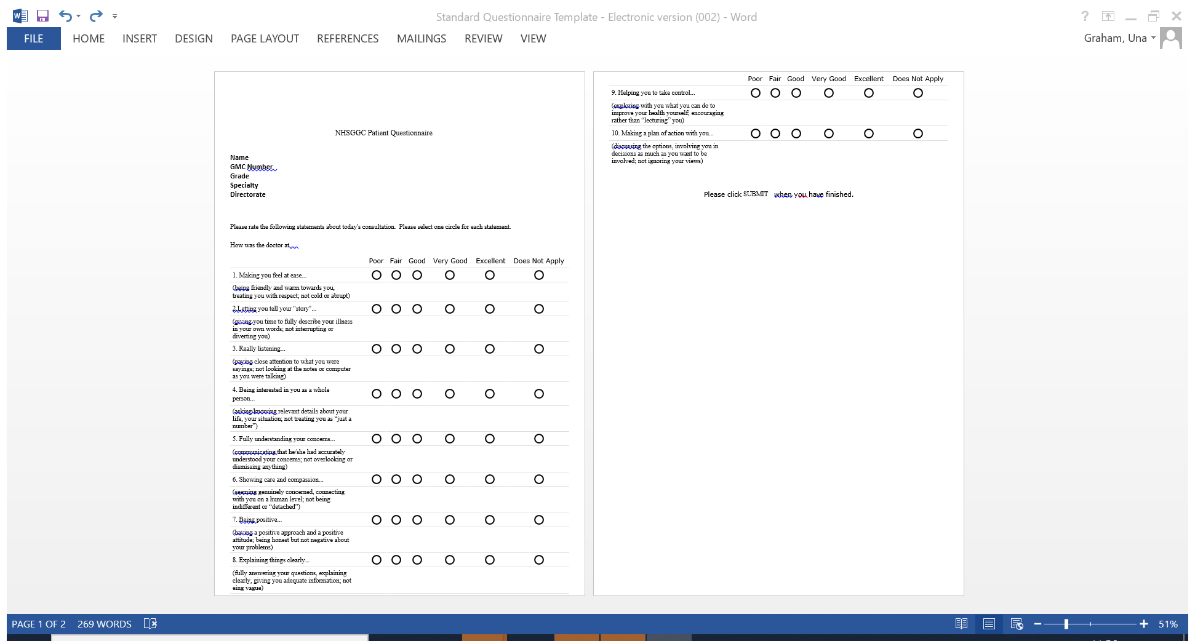

Slide 11
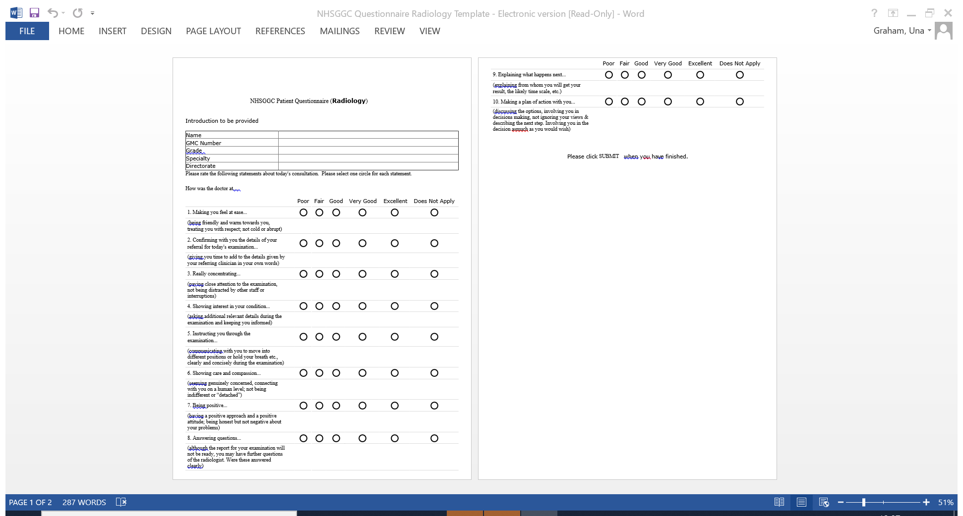

Slide 12
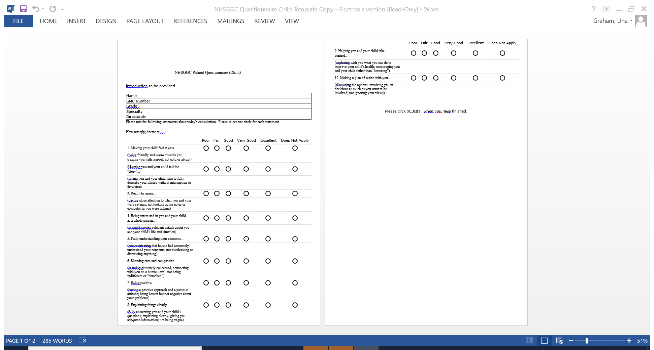

Slide 13
Results
87% of clinicians said that they would use the electronic system again to gather patient feedback
50% found it “very easy” to use
96% said it was beneficial to be able access their report online
Comments provided regarding the online report were that it was “excellent and easy to use” “well-constructed” “useful and straight forward”
Some doctors did not know how many people had been invited to complete and email addresses are not always recorded via track care
https://link.webropolsurveys.com/short/8039ac02c2054c7abec1eb539ba3c08c
61 completed

Slide 14
Next steps
Add boxes to allow the patient to indicate whether they are an in-patient, outpatient or day patient to allow doctors to identify which domains of practice patients have come from
Insertion of a comments box for free text
Notification of how many patients have been issued with the survey
QR code to also be added to the hard copy version of the Questionnaire for issue
Reminder to be issued by the system to patients who hadn’t responded and notification to doctor when threshold reached
Email addresses recorded

Slide 15
My personal experience
https://link.webropolsurveys.com/short/9d051bb31a1d45b286a161d0a87159a5

Slide 16




Slide 17
ePQ positives
Easy to use
Realtime results
Cost neutral- developed in house
Easy to administrate and collate results
Potential for expansion beyond apppraisal

Slide 18

The future for ePQ in GG&C
This Photo by Unknown Author is licensed under CC BY-SA-NC

