Slide 1
Refresher Appraiser Training
Medical Appraisal Scotland
Appraisal in the Trainer Role:
Secondary Care and University
(based on New Appraiser module)
This PowerPoint has no audio nor animations.
The audio has been transcribed in the Notes section for your reference.
Notes:
[Audio transcription]
Welcome to the New Appraiser Training module Appraisal in the Trainer Role aimed at secondary care and university roles.

Slide 2
Aims of this module
To develop confidence in discussing the trainer role and related supporting information and personal development plan with a Secondary Care trainer recognised by the GMC, or an appraisee planning to take up a trainer role.
Notes:
[Audio transcription]
The aim of this module is to help you develop the confidence to discuss the trainer role as part of the secondary care trainer appraisal. This will be discussing both the supporting information and the future Personal Development Plan relevant to this role. You may also use it for an appraisee who is planning to take up a trainer role in the future.

Slide 3
Learning outcomes
The role of the appraiser in supporting trainers to reflect on relevant supporting information
What kind of supporting information would be relevant to the different domains of the trainer framework
The role of the automated Form 7 created following the appraisal
How this fits into GMC revalidation
Notes:
[Audio transcription]
By the end of this session you will have an understanding of the role the appraiser plays in supporting trainers to reflect on relevant supporting information and what kind of supporting information would be relevant to the different domains of the trainer framework. You will also understand how the Form 7 is created in SOAR following an appraisal and what role it plays in the GMC revalidation for trainers.

Slide 4
In preparation for the first Teams day
Make notes of any remaining questions
Content here will form part of the Supporting Information discussion on day 1
Notes:
[Audio transcription]
In preparation for the first remote meeting on Teams please make a note of any remaining questions you may have after working through this module. The content used here will form part of the supporting information discussion on day one. You can either use your workbook or make separate notes on reflections to refer to on this day.

Slide 5
Background
Appraisal covers all roles
Relevant for trainers as well as trainees
Part of trainees’ ARCP process
Trainer information published on GMC register
SOAR supports revalidation of secondary care doctors in their trainer role(s)
Notes:
[Audio transcription]
As discussed in the supporting information module appraisal needs to cover all roles that a doctor has. This is relevant for both trainers and for trainees. For trainees, appraisal forms part of the ARCP process and is not done separately. Any doctor who is a trainer has that information published on the GMC medical register. SOAR is also set up to support revalidation of secondary care doctors in their trainer role and this module will explain further how this works.

Slide 6
GMC Trainer recognition
Formal recognition of trainers in secondary care was introduced in 2013
Doctors who fulfil the requirements have a note on their medical register entry to say ‘This doctor is a trainer recognised by the GMC’
Notes:
[Audio transcription]
Until 2013 there was only a formal approval process in place for GP trainers. This changed in 2013 when formal recognition of trainers in secondary care was introduced. Now all secondary care doctors who fulfil the requirement have a note on their medical register entry to say that ‘This doctor is a trainer recognised by the GMC’.

Slide 7
Relevant roles
Named postgraduate clinical supervisor
Named postgraduate educational supervisor
Lead coordinator of undergraduate training at each placement location; or
Doctor responsible for overseeing students’ educational progress at each medical school
Notes:
[Audio transcription]
Not all doctors involved in teaching and training of trainees or medical students require to be on the GMC register. The roles where this is relevant are named postgraduate clinical supervisor or educational supervisor or the university positions of lead coordinator of undergraduate training at each placement location or doctors responsible for overseeing students’ educational progress at each medical school.

Slide 8
GMC domains for trainer recognition
1. Ensuring safe and effective patient care through training
2. Establishing an effective learning environment
3. Teaching and facilitating learning
4. Enhancing learning through assessment
5. Supporting and monitoring progress
6. Guiding personal and professional development
7. Continuing professional development as an educator
Notes:
[Audio transcription]
These are the seven domains required for GMC trainer recognition. Apart from clinical supervisors who only need to provide evidence for one to four and seven all of these domains require evidence. In appraisal of a trainer you would expect to see evidence covering all of these domains over the five year revalidation period.

Slide 9
How does a trainer get recognised?
Initial recognition process outwith SOAR
Complete application form evidencing how they meet the criteria
Assessed by DME
Recommended as trainer on Turas
Information reviewed by NES or University
Recognised as trainer by NES or University
Notes:
[Audio transcription]
While some prospective trainers may discuss the evidence they are going to use for their application as part of the appraisal the initial recognition process sits outside of SOAR or the appraisal process. Prospective trainers complete an application form evidencing how they the meet criteria discussed in the previous slide. This is then assessed by the Director of Medical Education and if appropriate the doctor is recommended as a trainer on Turas. The information is reviewed either by NES or the university depending on the trainee role and they then recognise the person as a trainer. This information is passed onto the GMC who then enters the doctor onto their trainer register.

Slide 10
Role of appraisal in Recognition of Trainers (RoT)
Trainers are revalidated in the trainer role as well as their clinical role every 5 years
The RoT element of the appraisal allows trainers to demonstrate how they ‘remain up-to-date and fit-to-practise’ in this role
Equality and diversity training
Time in the job plan allocated to the listed role(s)
Supporting evidence for the seven framework areas
Notes:
[Audio transcription]
Trainers are revalidated in the trainer role as well as their clinical role every five years. The appraisers role is as a facilitator to guide the reflection of the trainer. The main focus of the discussion remains how the trainer is getting on in their role, their achievements, any challenges and any further developments they have identified in this part of their job. SOAR is also used to provide evidence for the revalidation in the trainer role and in order to support this these three elements should be included in the discussion;
Equality and diversity training
Time in the job plan allocated to the trainer for the listed role
The supporting evidence for the seven framework areas previously discussed.

Slide 11
SOAR and RoT
Trainers complete Form 3 (Domain 1 | RoT)
Appraisers complete Form 4
Elements of both related to RoT (including supporting information uploaded) are automatically extracted and combined into Form 7 after the appraisal
DME has access to Form 7s for re-recognition (not to any other part of the appraisal)
Notes:
[Audio transcription]
SOAR includes a specific element for recognition of training in Domain 1 on Form 3. It is very important that a trainer uses this area to record any of the information relevant to the trainer role. Appraisers complete their Form 4 write up as usual and again making sure they include any discussion relevant to their trainer role in the relevant part of the Form 4. Both of these elements are automatically extracted into the Form 7 and this also includes any of the supporting information that is uploaded specifically to this area of the SOAR portfolio.
DME has access to Form 7s for re-recognition of a trainer. This does not include any other part of the appraisal. In order to make the process as easy and straight forward for the trainer it is important that both trainer and appraiser use the relevant part of the portfolio to record the discussion relevant for the trainer role.

Slide 12
Advice on SOAR re RoT
Notes:
[Audio transcription]
SOAR includes further guidance on the ROT process. You can refer any trainer who is unsure as to what to include to this area which also includes a link to the Scottish trainer framework website which gives more detailed information.

Slide 13
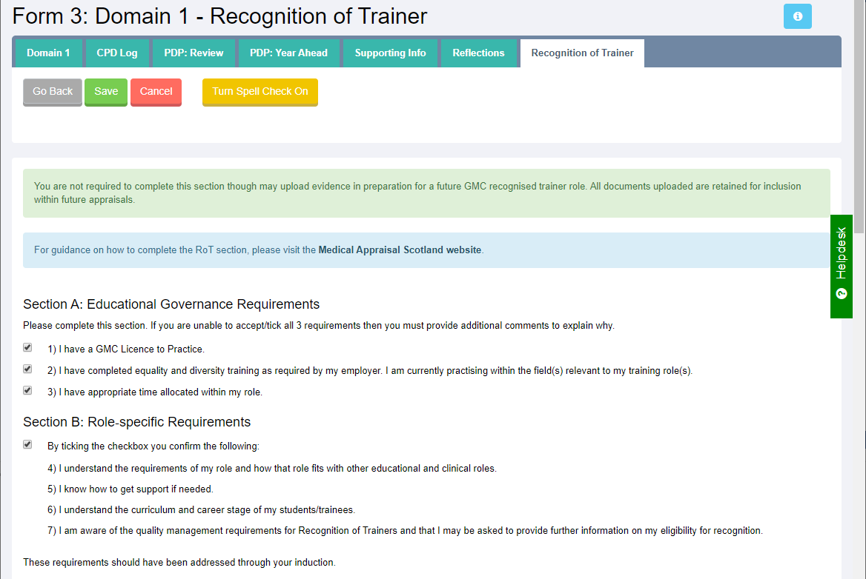
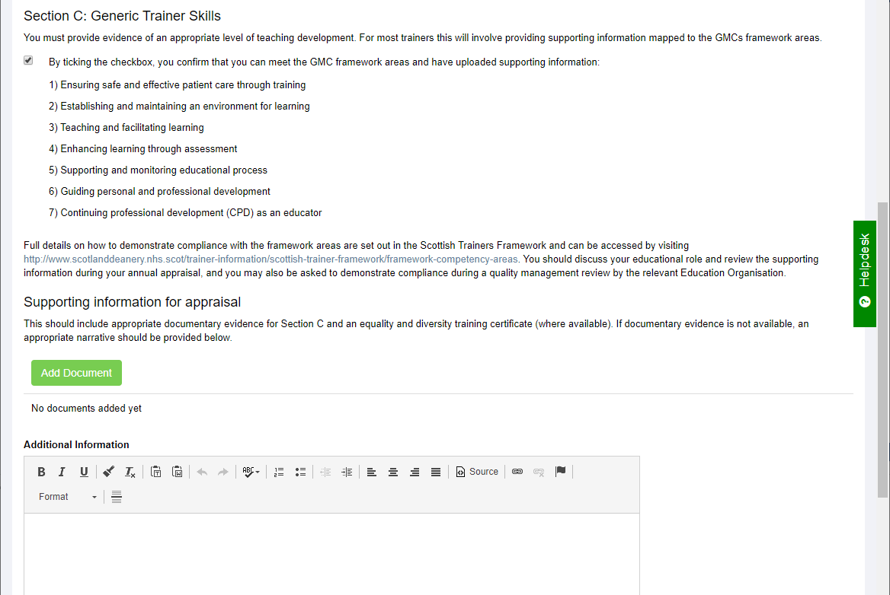
What the appraisee completes (Form 3)
Notes:
[Audio transcription]
This is the element of the Form 3 Domain 1 that the appraisee completes for Recognition of Trainers. The initial part helps them confirm that they meet the educational governance and role specific requirements. This is followed by a box that allows them to record their reflection of anything specific to their trainer role and also allows them to upload any supporting information relevant to this directly to this part of the portfolio.

Slide 14
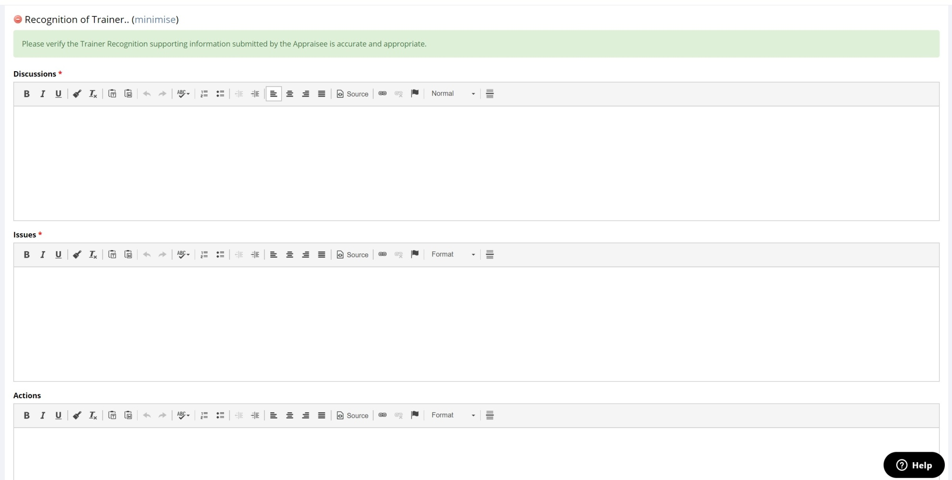
What the appraiser completes (Form 4)
Notes:
[Audio transcription]
As part of the preparation of the Form 4 you would record any of the relevant discussion in the trainer role in this area. You need to complete both the discussion and the issues box and can also record actions, for example, what PDP elements relevant to the trainer role the appraisee is going to include going forward.

Slide 15
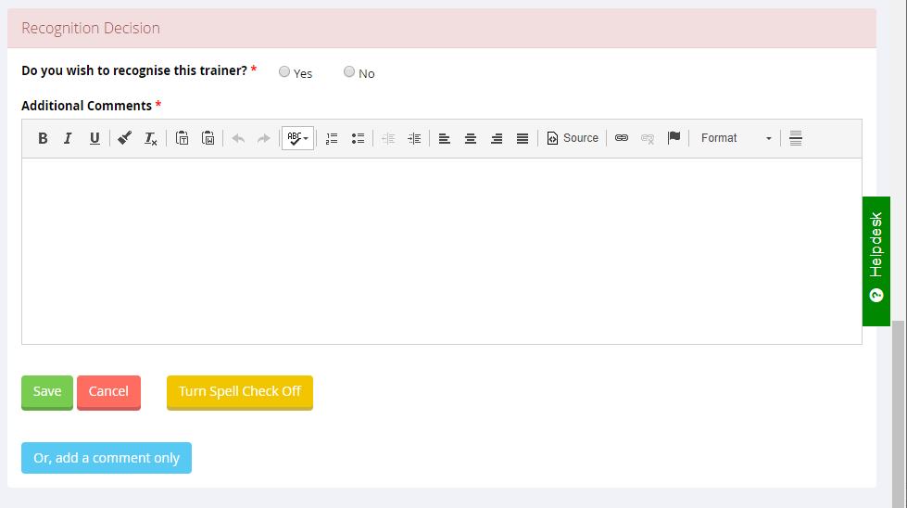
What the DME does (Form 7)
Notes:
[Audio transcription]
As the doctor comes up for revalidation the Director of Medical Education will review the Form 7s and ensure that all the requirements for the trainer framework are met. They can then record that they recognise this trainer going forward and can include additional comments as required. They would also use this to flag up any outstanding actions for example, a refresher of the equality and diversity training prior to being able to recommend them if the trainer does not meet all requirements at this stage.

Slide 16
Your role as appraiser
Review and discuss the supporting evidence submitted for RoT with the appraisee
Confirm that appropriate supporting information has been provided for the roles undertaken
Not your role to recognise trainers
Notes:
[Audio transcription]
As an appraiser it is not your role to recognise the trainer. Your role is to facilitate the reflection on the supporting evidence an appraisee has submitted for their trainer role and also confirm that this is appropriate for the roles they have undertaken. This is no different to any of the other elements of the appraisees portfolio. You help them with their reflection if they are up to date and fit to practice in this role just like you do with their clinical role.

Slide 17
Supporting information
What you do
Why you do it in that way
How well you do it
Notes:
[Audio transcription]
If you remind yourself what supporting information is for, the doctor shows you what they do, why they do it the way that they do it and what evidence they have how well they do it. This is what you use as the basis for their reflective discussion you have with them.

Slide 18
Types of supporting information
For all domains:
Training attended (e.g. FDA courses)
Relevant e-learning packages (e.g. e-learning for Health Educator Hub)
Reflections on your current practice
Critical analysis of relevant literature
Notes:
[Audio transcription]
There are certain types of supporting information that would be relevant for all domains. This includes training attended, for example, some of the Faculty Development Alliance training for trainer courses. The Scotland Deanery offers trainer workshops as well as supporting trainees with difficulties and advanced medical educator courses. There are also relevant e-learning packages for example, those offered by the Health Educator Hub. In addition reflections on the current practice as a trainer or critical analysis of relevant literature would be appropriate to use.

Slide 19
Reflections on
GMC Trainee Survey Results/National Student Survey
Other feedback from trainees/students
Feedback from peers
Feedback from Deanery visits/University QA processes
Relevant local audits/patient feedback/student evaluation data
Notes:
[Audio transcription]
For all of these areas of supporting information it needs to be seen in the context of the trainer role so it needs to be relevant to either trainees or medical students. There are various documents and other things that people can reflect on, for example, the GMC Trainee Survey results or National Student Survey and other forms of feedback from a variety of sources. It is also possible to include the evaluation of local audits or patient feedback exercises that trainees or medical students have been involved in and you have supported them in that.

Slide 20
Domain 1: Ensuring safe and effective patient care through training
M&M meetings (anonymised)
Induction timetables
Arrangements for supervision
Minutes of relevant Senior Staff Meetings
Anonymised discussions with or about trainees/students in difficulty
Case Based Discussion
Supervision of a QIP/ Audit completed by a trainee/student
Notes:
[Audio transcription]
Certain types of evidence would be specific to domains so let’s start by looking at Domain 1.
It could potentially be minutes of anonymised M&M meetings where incidents involve trainees and a reflection would be included on the outcome of the discussion and plans to remedy the situation. It could include induction timetables - why has the trainer chosen to cover the things they cover? And did they have any feedback on it they can reflect on? What arrangements are they making for the supervision of trainees and students, and how do they ensure these are robust?
Minutes of relevant senior staff meetings may, for example, include discussions about trainees, students or the general training environment, including how the educational impact was considered and discussed with trainees or students where any service changes are made. It could also include a discussion about the support put in place to protect trainees and patients in situations where the trainee is in difficulty, or trainers may use some case based discussions where the trainee took responsibility for an aspect of the patient care.
Some trainers will also supervise quality improvement projects or audits that are completed by a trainee or student on a block placement and again that would be appropriate evidence to use here.

Slide 21
Domain 2: Establishing and Maintaining an environment for learning
Induction
Meetings where trainee/student feedback/ NTS etc is discussed
Reflections on feedback received from trainees/students
Reflections on a teaching session delivered by a trainee or a peer
Departmental education programme/course you teach based on curriculae
Teaching timetables
Examples of when trainees have spoken out when a mistake was made or if they felt something was wrong – because they felt safe to do so – what did you do?
Notes:
[Audio transcription]
As you see from the list on Domain 2 there is a degree of overlap with Domain 1, for example in induction arrangements. This is also an area where feedback is very important and where you would consider what the feedback has meant for the environment for learning and how you have potentially improved the situation to enable better teaching and training.
Another relevant thing to include here would be how you ensure that the team and trainers are aware of the curriculum and stage of training for students and trainees, and what they mainly need to focus on in their learning during their time with you. You may also have examples where trainee has spoken out when they felt a mistake was made or something was wrong. What did the trainer do to ensure they felt safe to raise these concerns and what did they do in response to it?

Slide 22
Domain 3: Teaching and facilitating learning
Teaching programmes for your department
Teaching plans and evaluations
A review of a teaching session by a peer
Courses you are involved in delivering
Any certificate of a course related to teaching and facilitating learning
Notes:
[Audio transcription]
Looking at Domain 3, one suitable example would be teaching programmes. Are they mapped to the curriculum and why does the trainer chose to deliver things the way they do and at the time they are offered? It would also be useful to have a review of a teaching session by your peer and have an assessment of courses that they are involved in delivering. Most of these include some feedback from attendees that can be discussed including any changes or improvements that the trainer has made as a result of it.

Slide 23
Domain 4: Enhancing learning through assessment
Anonymised examples of completed WPBAs or Educational Supervisors reports
Questions you have written for college exams
Feedback given to candidates after an exam
Examples of assessments you have devised for use in your area
Certificates from acting as an examiner
Feedback given to a trainee as part of a learning event
Notes:
[Audio transcription]
All trainers will be involved in some assessment processes. This will range from completing workplace based assessments for individual trainees through to reports as educational or clinical supervisors and assessments as part of college exams. Any of these can be used in this area and it may also include any feedback you have given to a trainee directly as part of a learning event.
You may want to discuss with the trainer if they are the hawk or a dove? How would they know and what feedback have they had, for example, as part of being an assessor?

Slide 24
Domain 5: Supporting and monitoring educational progress (Educational Supervisors)
Induction/midpoint and end of block meeting entry for a trainee
Anonymised example of when you had a trainee in difficulty
PDP plan agreed with a trainee
ARCP panels – details of this (anonymised appropriately)
Notes from Speciality Training Committee meetings
Evidence of attendance at trainee interviews
Meeting notes when trainees discussed to monitor progress and highlight concerns
Notes:
[Audio transcription]
This is Domain 5 specifically for Educational Supervisors. Here you would expect the trainer to reflect for example on induction/midpoint or end of block meeting entries into the portfolio of a trainee, or some anonymised examples of dealing with a trainee in difficulty. What did they do? Why did they do it that way and did it work? It could also include examples of PDP agreed with the trainee or anonymised ARCP panel details. Other suitable evidence would be notes from Speciality Training Committee meetings or attendance at trainee interviews or other meetings where trainee progress was discussed.

Slide 25
Domain 5: Supporting and monitoring educational progress (University roles)
Anonymised completion of assessment requirements for a clinical block with feedback to student
Attendance at EO training events relating to student assessment
Anonymised evidence of participation in exam boards
Evidence of facilitation and assessment of e.g. student projects
Participation on, training for and undertaking student selection activities for admission
Notes:
[Audio transcription]
Looking at Domain 5 for somebody in a university trainer role. Here suitable evidence would be anonymised completion of assessments for students. Also, attendance for example, at university training events relating to student assessment or evidence of participation in exam boards. Trainers could also show how they facilitate and assess student projects and how they take part in training or undertake student selection activities for admission so being part of interview panels for example.

Slide 26
Domain 6: Guiding personal and professional development (Educational Supervisors)
Reflective account of when you have given advice and support
Examples of printed/electronic materials you provided to trainees
Feedback or letters of thanks from trainees
Notes:
[Audio transcription]
Under Domain 6 for Educational Supervisors, trainers for example, may give a reflective account of advice or support they have given to a trainee. It could also include examples of printed or electronic material that they offer trainees who are looking for support or feedback letters and thank you’s from trainees who have received that support previously.

Slide 27
Domain 6: Guiding personal and professional development (University roles)
Evidence of training on / participation in careers guidance for students
Evidence of attending training on pastoral or professional development for students
Evidence of training on inclusivity e.g. reasonable adjustments for disability
Reflection of pastoral and or professionalism activities e.g. student mentor activities, Health and conduct or fitness to practice activities
Notes:
[Audio transcription]
Under Domain 6 for university roles, evidence of training or participation in career guidance for students would also be applicable equivalent to the secondary care role for trainees.
In addition, there could also be evidence of training in roles where you support students be that in a pastoral role for their professional development or training on inclusivity so knowing how to make reasonable adjustments for disabilities a student may have. Of course any reflection on participation in related activities would equally apply so, for example, being a student mentor.

Slide 28
Domain 7: Continuing professional development as an educator
All domains mentioned count: this is about a PDP in the trainer role
Reflection on next steps
Suitable evidence
Consider how the evidence informed your development
Any changes to curriculum?
e.g. Simulation; Doctors/Students in difficulty
Any gaps?
Notes:
[Audio transcription]
Domain 7 really brings all this together. This is around your own development and learning as a medical educator. All evidence that a trainer has provided in the previous section counts towards this one but it needs to include some plans and actions around their own development, so the kind of questions you could explore with them are - what are the expectations for your role going forward? What are your plans for meeting them and how will you evidence this? Are there any minimum requirements for your role?
Suitable evidence potentially would be - how has all the evidence you have presented informed your development and choices when planning educational encounters? Are there any changes in the training programme on the horizon? How will you prepare individually and as a department for this? Do you want to learn to deliver simulation? Do you want to improve your teaching techniques generally and how are you going to go about this? What gaps have you identified and what can you do to fill them?

Slide 29
Ongoing trainer status
Evidence covering the 5-year revalidation cycle that the trainer continues to remain up-to-date in all elements of their trainer role.
Notes:
[Audio transcription]
Ongoing trainer status does not require anything in addition. If people have discussed the trainer role at every appraisal they should have covered all the required evidence over their 5-year revalidation cycle and will be able to prove that they remain up to date in all elements of their trainer role.

