Slide 1
REFLECTING ON REFLECTIVE PRACTICE – LESSONS FOR APPRAISAL
Dr Robert A Hendry
Medical Director

Slide 3
The joy of reflection
“Reflection must be reserved for solitary hours; whenever she was alone, she gave way to it as the greatest relief; and not a day went by without a solitary walk, in which she might indulge in all the delight of unpleasant recollections.”
Jane Austen
“PRIDE AND PREJUDICE”
https://en.wikipedia.org/wiki/File:Jane_Austen_coloured_version.jpg

Slide 4
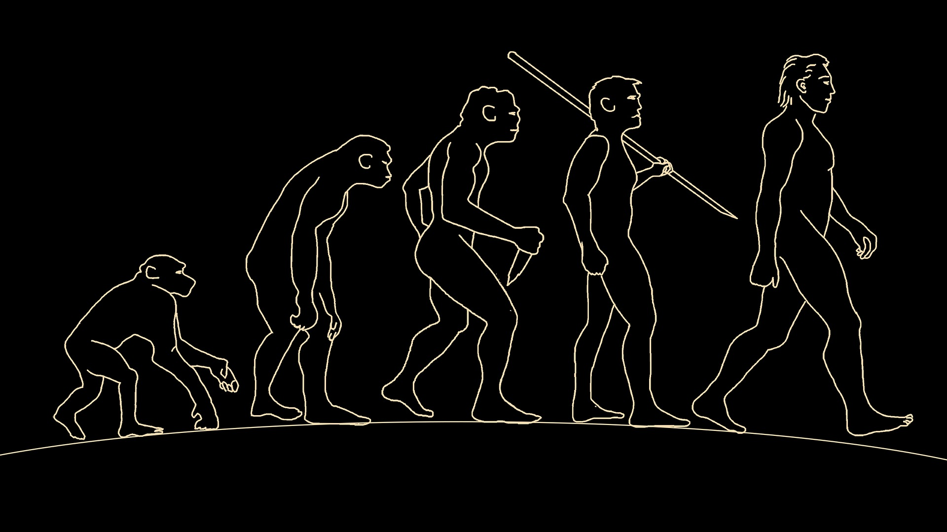
What makes humans unique?
https://pixabay.com/illustrations/man-human-evolution-body-3579185/

Slide 5
Why the worry about writing reflections?
Criminal proceedings
MPTS

Slide 6
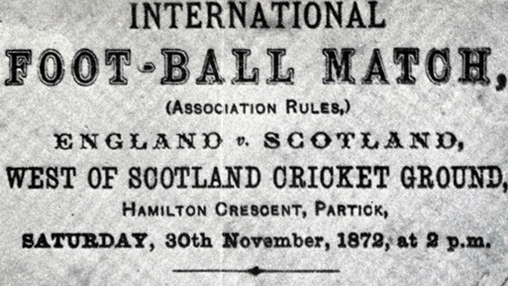
Different countries – Different legal system
https://commons.wikimedia.org/wiki/File:England_v_scotland_1872_ad.jpg

Slide 7
Gross Negligence Manslaughter
Prosecution has to prove that:
The doctor owed a duty of care to the deceased;
The doctor breached that duty of care;
It was reasonably foreseeable that the breach of their duty of care gave rise to a serious and obvious risk of death;
The doctor’s breach of their duty caused the death of the patient because it was a significant contributory factor; and
Having regard to the risk of death, the doctor’s conduct was so bad in all the circumstances as to amount to a crime.

Slide 8
The Fall Out
Williams Inquiry
DHSC working party
Independent review of GNM and CH
AoRMC guidance

Slide 9
Making decision on cases at the end of the investigation stage: Guidance for the Investigation Committee and case examiners

Slide 10
Remediation – whether the failing is easily remediable and has been remedied
72 In the case of Cohen v General Medical Council [2008] EWHC 58, Mr Justice Silber ruled that at the impairment stage, a tribunal ought to take account of evidence and/or submissions (in addition to those deployed at the fact-finding stage) from both the doctor and the GMC that the doctor’s failing:
is easily remediable
and that it has already been remedied
and that it is highly unlikely to be repeated

Slide 11
Sanctions Guidance
Mitigating and aggravating factors to consider when deciding on a sanction

Slide 12
The doctor’s insight into the concerns
46 A doctor is likely to have insight if they:
accept they should have behaved differently (showing empathy and understanding)
take timely steps to remediate and apologise at an early stage before the hearing
demonstrate the timely development of insight during the investigation and hearing

Slide 13
Lack of insight
52 A doctor is likely to lack insight if they:
refuse to apologise or accept their mistakes
promise to remediate but fail to take appropriate steps, or only do so when prompted immediately before or during the hearing
do not demonstrate the timely development of insight
fail to tell the truth during the hearing

Slide 14
Ten key points on being a reflective practitioner
Reflection is personal and there is no one way to reflect. A variety of tools are available to support structured thinking that help to focus on the quality of reflections.
Having time to reflect on both positive and negative experiences – and being supported to reflect – is important for individual wellbeing and development.
Group reflection often leads to ideas or actions that can improve patient care.
The healthcare team should have opportunities to reflect and discuss openly and honestly what has happened and when things go wrong.
A reflective note does not need to capture full details of an experience, it should capture learning outcomes and future plans.

Slide 15
Ten key points on being a reflective practitioner (cont)
Reflection should not substitute or override other processes that are necessary to record, escalate or discuss significant events and serious incidents.
When keeping a note, the information should be anonymised as far as possible.
The GMC does not ask a doctor to provide their reflective notes in order to investigate a concern about them. They can choose to offer them as evidence of insight into their practice.
Reflective notes can currently be required by a Court. They should focus on the learning rather than a full discussion of the case or situation. Factual details should be recorded elsewhere.
Tutors, supervisors, appraisers and employers should support time and space for individual and group reflection.

Slide 16
Duty of Candour, patient safety and medical accountability Are there conflicts?
The overall purpose of the new DUTY is to ensure that ORGANISATIONS are open, honest and supportive when there is an unexpected or unintended incident resulting in death or harm.

Slide 17
The fall out – what does it mean for doctors?
“The Science of Happiness”
Dr Tony Fernando Senior Lecturer Psychological Medicine Faculty of Medical and Health Sciences University of Auckland
November 2014
https://www.youtube.com/watch?v=-71koNsCEds

Slide 18
Self compassion
Gratitude Exercise
Write down 3 good things that happened daily for a week
self-compassion.org
Compassionatemind.co.uk

Slide 19
Discussion

