Slide 2
Drs Sarah Luty and Duncan McNab
Associate Advisors, Safety and Improvement
Sarah.luty@nes.scot.nhs.uk
Duncan.McNab@nes.scot.nhs.uk
#NESSME19
@DrSarahLuty
@Duncansmcnab

Slide 3
Learning outcomes
Explore reflection as a tool to inform improvement areas.
Review of QIA for appraisal using validated peer review instrument.
Plan next steps following appraisal.
Notes:
Could also include plan next project?

Slide 4

Definition of QIA?
GMC
  Quality improvement activities should be robust, systematic and relevant to your work. They should include an element of evaluation and action, and where possible, demonstrate an outcome or change.

Slide 5
Systematic and robust method
Evaluation and Reflection
Leading to change

Slide 6
Reflection to INFORM QIA?
In groups 5 minutes to discuss hoe reflecting on daily work can help
help inform and
set priorities for QIA?

Slide 7
Incident Investigation/ Complaints
MSF
PSQ
Data- national/ local
Patient feedback
Guidelines
CPD
Professional conversations
Notes:
For each go through systematic and robust method? Evaluation and reflection? Leading to change?

Slide 8


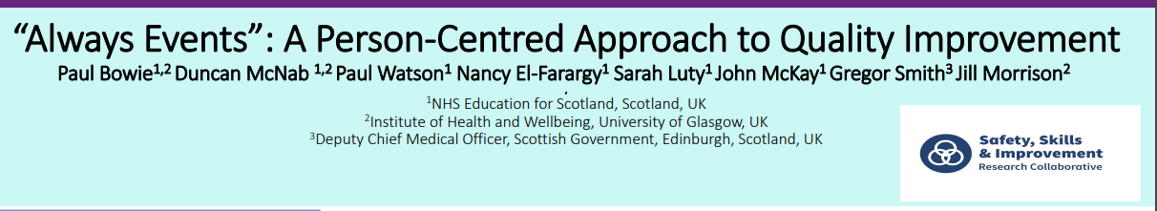
Lovely Nurses? Caring Practice?

Slide 9
Reflection demonstrated in submitted QIA projects?
5 minutes in groups discuss:
Reflection as part of the QI project (demonstrated in the report submitted in appraisal)

Slide 10
QIA reflection in the Appraisal.
QI Project review tool:
Developed by NES in Safety and improvement Team
Literature Review
Adaption of Template
Content Validity Index
Inter- rater reliability testing
Notes:
How can appraiser enhance that reflection to inform future QI

Slide 11
In groups of 2-3
Using the QI Project review tool discuss one of the reports available- or your own example.

Slide 12
Feedback
In tables
Does the review tool help with reflection on a QI report?
What changes would make it more useful in your setting?

Slide 15
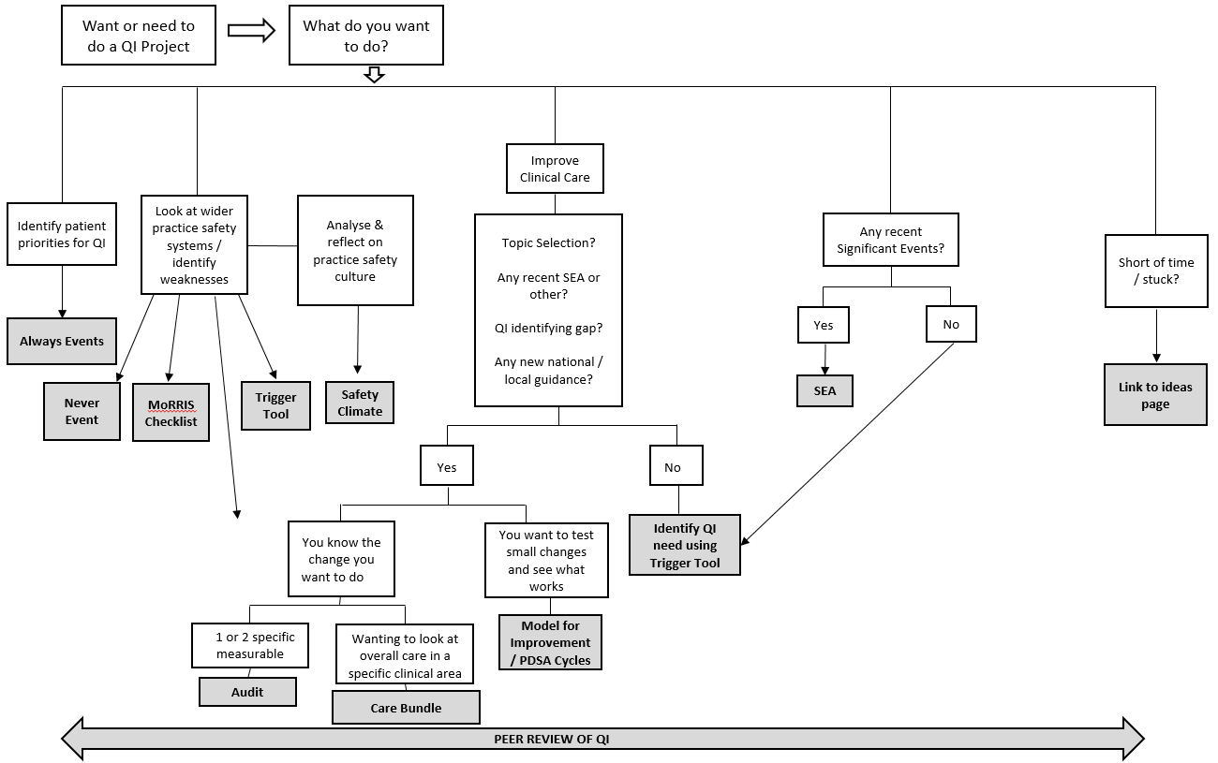
QI Training for Appraisal

