Slide 1
Good medical practice 2024

Slide 2
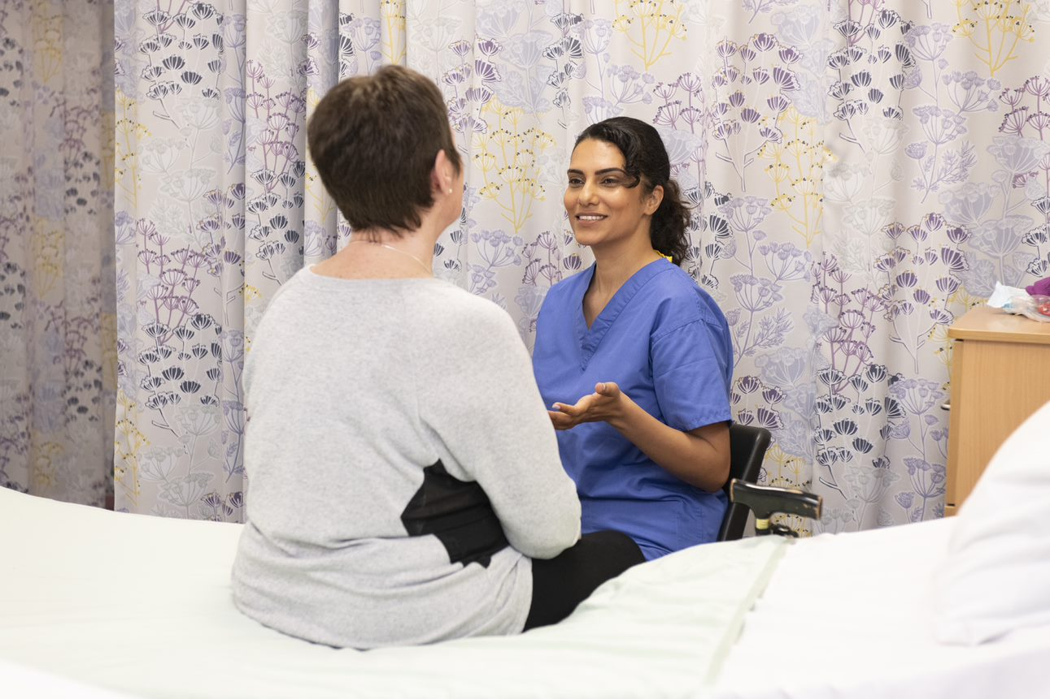
Good medical practice is at the heart of UK healthcare. It sets the standards of care and professional behaviour expected of all medical professionals registered with us.

Slide 3
Quick question:
How often do you refer to GMC Good medical practice to support appraiser’s role?
Frequently for my own use as well as appraiser role
Regularly in my appraisers role but not much at other times
Not very often
Only refer to it when there is a problem
I don’t remember the last time accessed Good medical practice

Slide 4
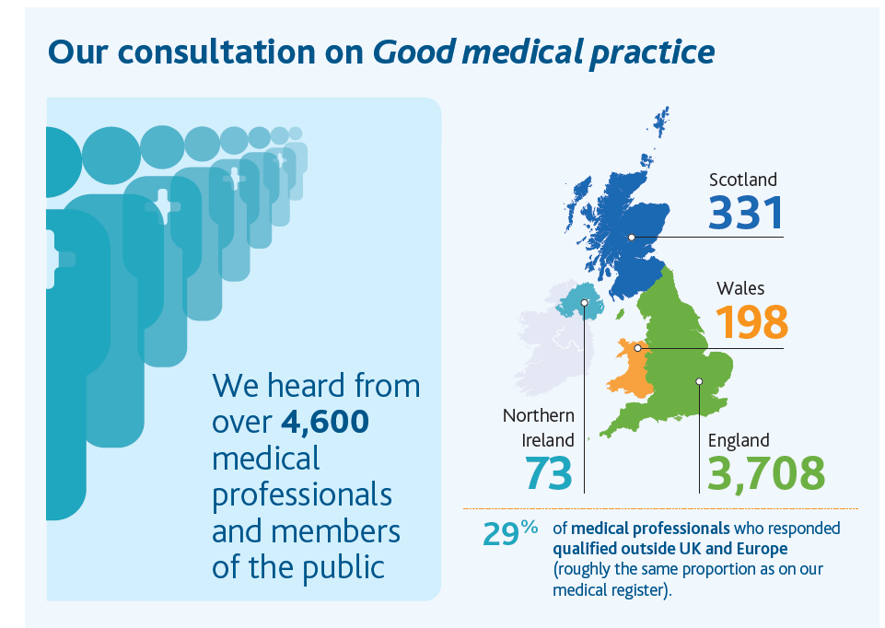
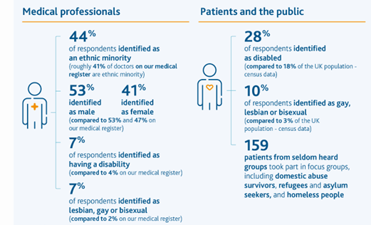
The consultation

Slide 5

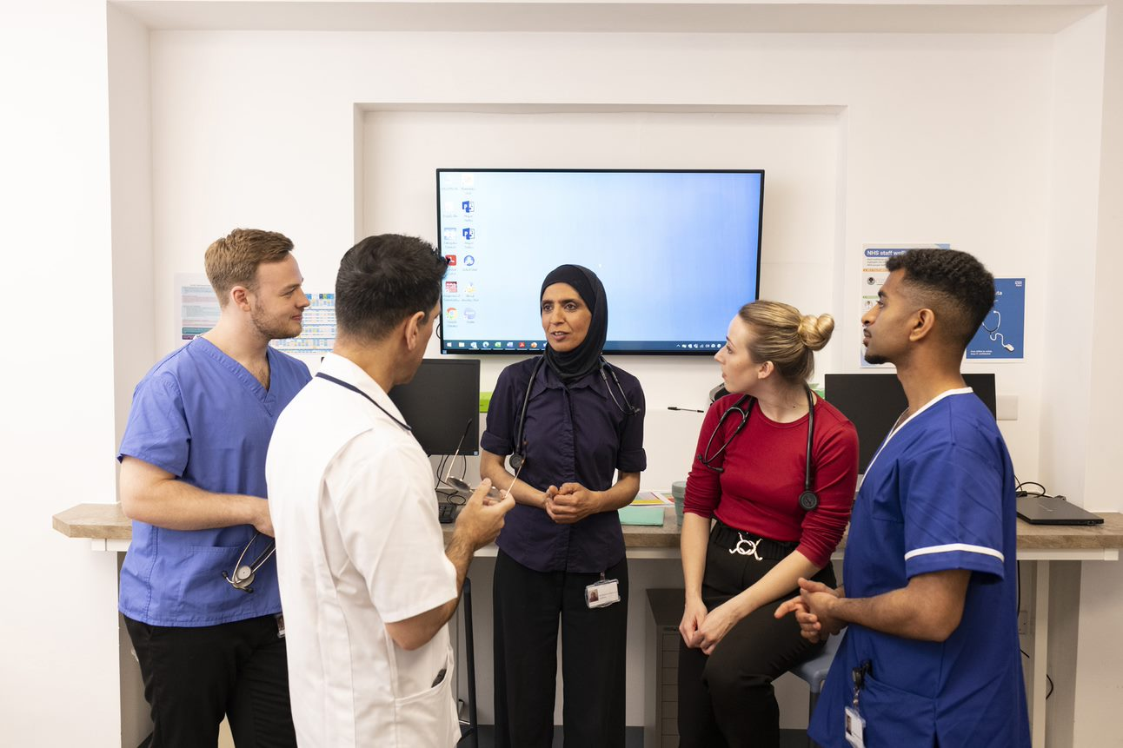
Five key themes
Creating respectful, fair and compassionate workplaces
Promoting patient centred care
Helping to tackle discrimination
Championing fair and inclusive leadership
Supporting continuity of care and safe delegation

Slide 6
Creating respectful, fair and compassionate workplaces
48. You must treat colleagues with kindness, courtesy and respect.
51. You must be compassionate towards colleagues who have problems with their performance or health. But you must put patient safety first at all times.
52. You must help to create a culture that is respectful, fair, supportive, and compassionate by role modelling behaviours consistent with these values.
53. You should be aware of how your behaviour may influence others within and outside the team.

Slide 7

Promoting patient centred care
32 You must take steps to meet patients’ language and communication needs, so you can support them to engage in meaningful dialogue and make informed decisions about their care. The steps you take should be proportionate to the circumstances, including the patient’s needs and the seriousness of their condition(s), the urgency of the situation and the availability of resources.
40 If a patient is taking multiple medications, you should discuss the importance of regular reviews to check that the medications continue to meet the patient’s needs and are optimised for them. You should consider the overall impact of the patient’s treatments, and whether the benefits outweigh any risk of harm.

Slide 8
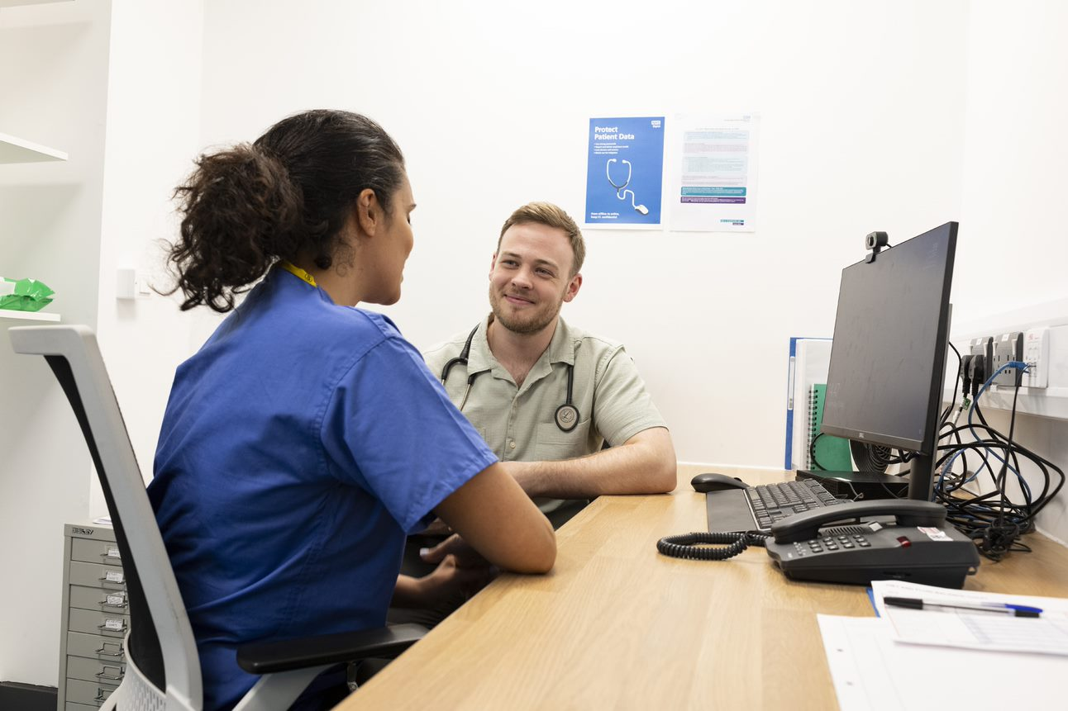
Helping to tackle discrimination
56. You must not abuse, discriminate against, bully, or harass anyone based on their personal characteristics, or for any other reason. By ‘personal characteristics’ we mean someone’s appearance, lifestyle, culture, their social or economic status, or any of the characteristics protected by legislation – age, disability, gender reassignment, race, marriage and civil partnership, pregnancy and maternity, religion or belief, sex and sexual orientation
57. You must not act in a sexual way towards colleagues with the effect or purpose of causing offence, embarrassment, humiliation or distress. What we mean by acting ‘in a sexual way’ can include – but isn’t limited to – verbal or written comments, displaying or sharing images, as well as unwelcome physical contact.

Slide 9
Helping to tackle discrimination
58. If you witness any of the behaviours described in paragraphs 56 or 57 you should act, taking account of the specific circumstances. For example, you could:
check in and offer support to anyone targeted or affected by the behaviour, and/or let them know that you feel that the behaviour you witnessed is unacceptable
challenge the behaviour by speaking to the person responsible – either at the time, if safe to do so, or at an appropriate time and place
speak to a colleague and/or consider reporting the behaviour in line with your workplace policy and our more detailed guidance on Raising and acting on concerns about patient safety. Before you report the behaviour you witnessed, try and make sure that the person who was targeted is aware of, and supports, your intention to report it.
We recognise some people may find it harder than others to speak up but everyone has a responsibility – to themselves and their colleagues – to do something to prevent these behaviours continuing and contributing to a negative, unsafe environment.

Slide 10
Tackling discrimination
59. If you have a formal leadership or management role and you witness – or are made aware of – any of the behaviours described in paragraphs 56 or 57, you must act. You must:
make sure such behaviours are adequately addressed
make sure people are supported where necessary, and
make sure concerns are dealt with promptly, being escalated where necessary.

Slide 11
Championing fair, inclusive leadership
54. You should be aware of the risk of bias, and consider how your own life experience, culture and beliefs influence your interactions with others, and may impact on your decisions and actions.
55. You must show respect for, and sensitivity towards, others’ life experience, cultures and beliefs.

Slide 12
Championing fair, inclusive leadership and compassionate workplaces
59. If you have a formal leadership or management role and you witness – or are made aware of – any of the behaviours described in paragraphs 56 or 57, you must act. You must:
make sure such behaviours are adequately addressed
make sure people are supported where necessary, and make sure concerns are dealt with promptly, being escalated where necessary.

Slide 13
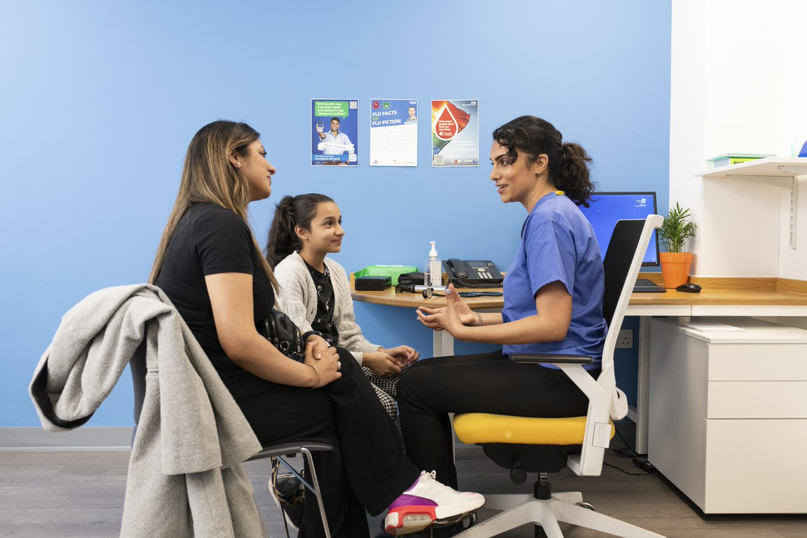
Supporting continuity of care and safe delegation
66. You must be confident that any person you delegate to has the necessary knowledge, skills and training to carry out the task you’re delegating. You must give them clear instructions and encourage them to ask questions and seek support or supervision if they need it.
67. If a task is delegated to you by a colleague but you’re not confident you have the necessary knowledge, skills or training to carry it out safely, you must prioritise patient safety and seek help, even if you’ve already agreed to carry out the task independently.

Slide 14
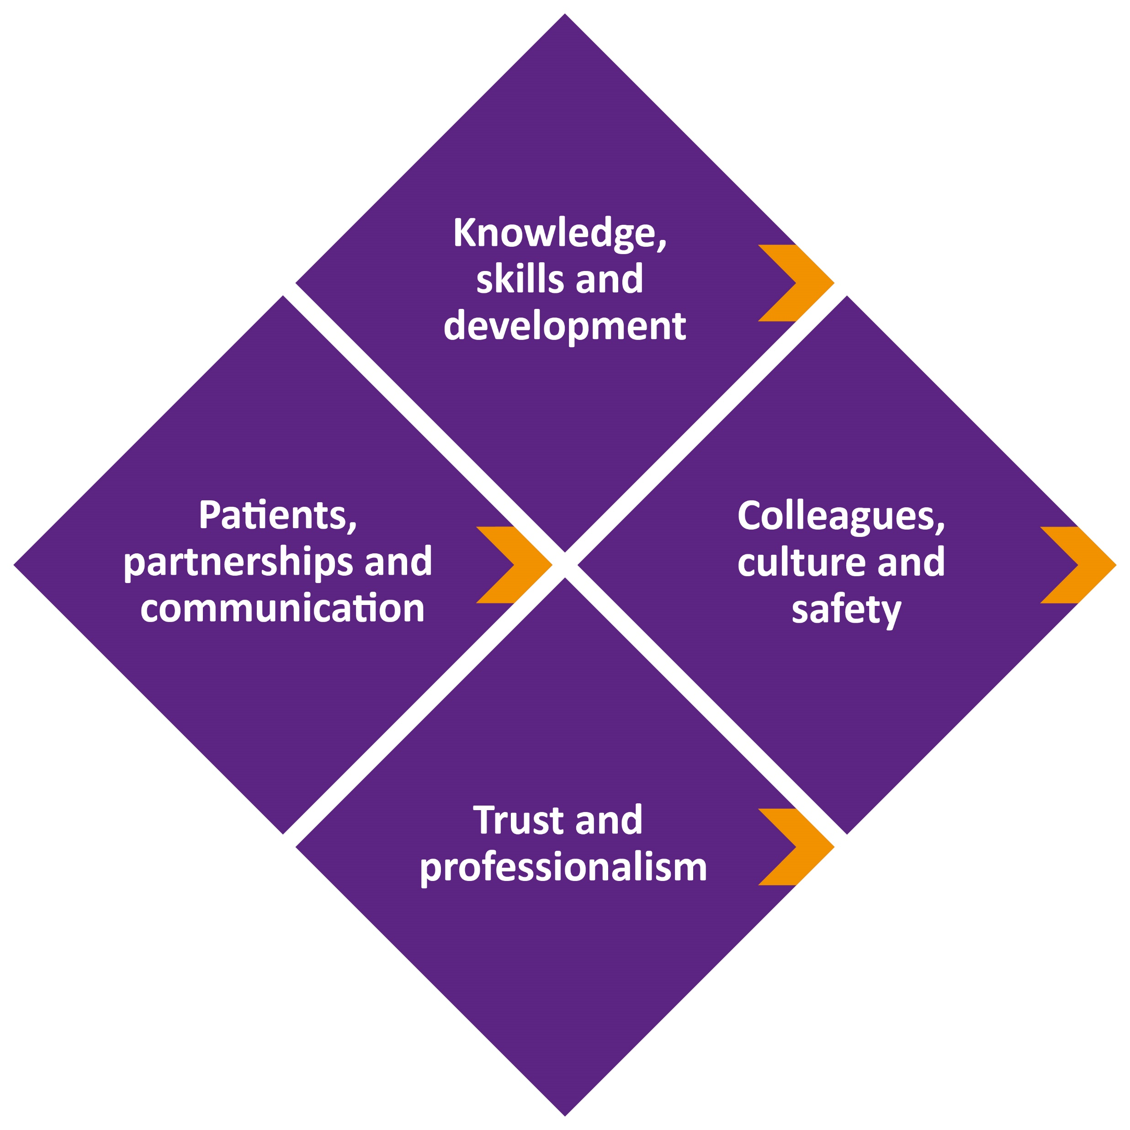
An overview
- the four domains

Slide 15
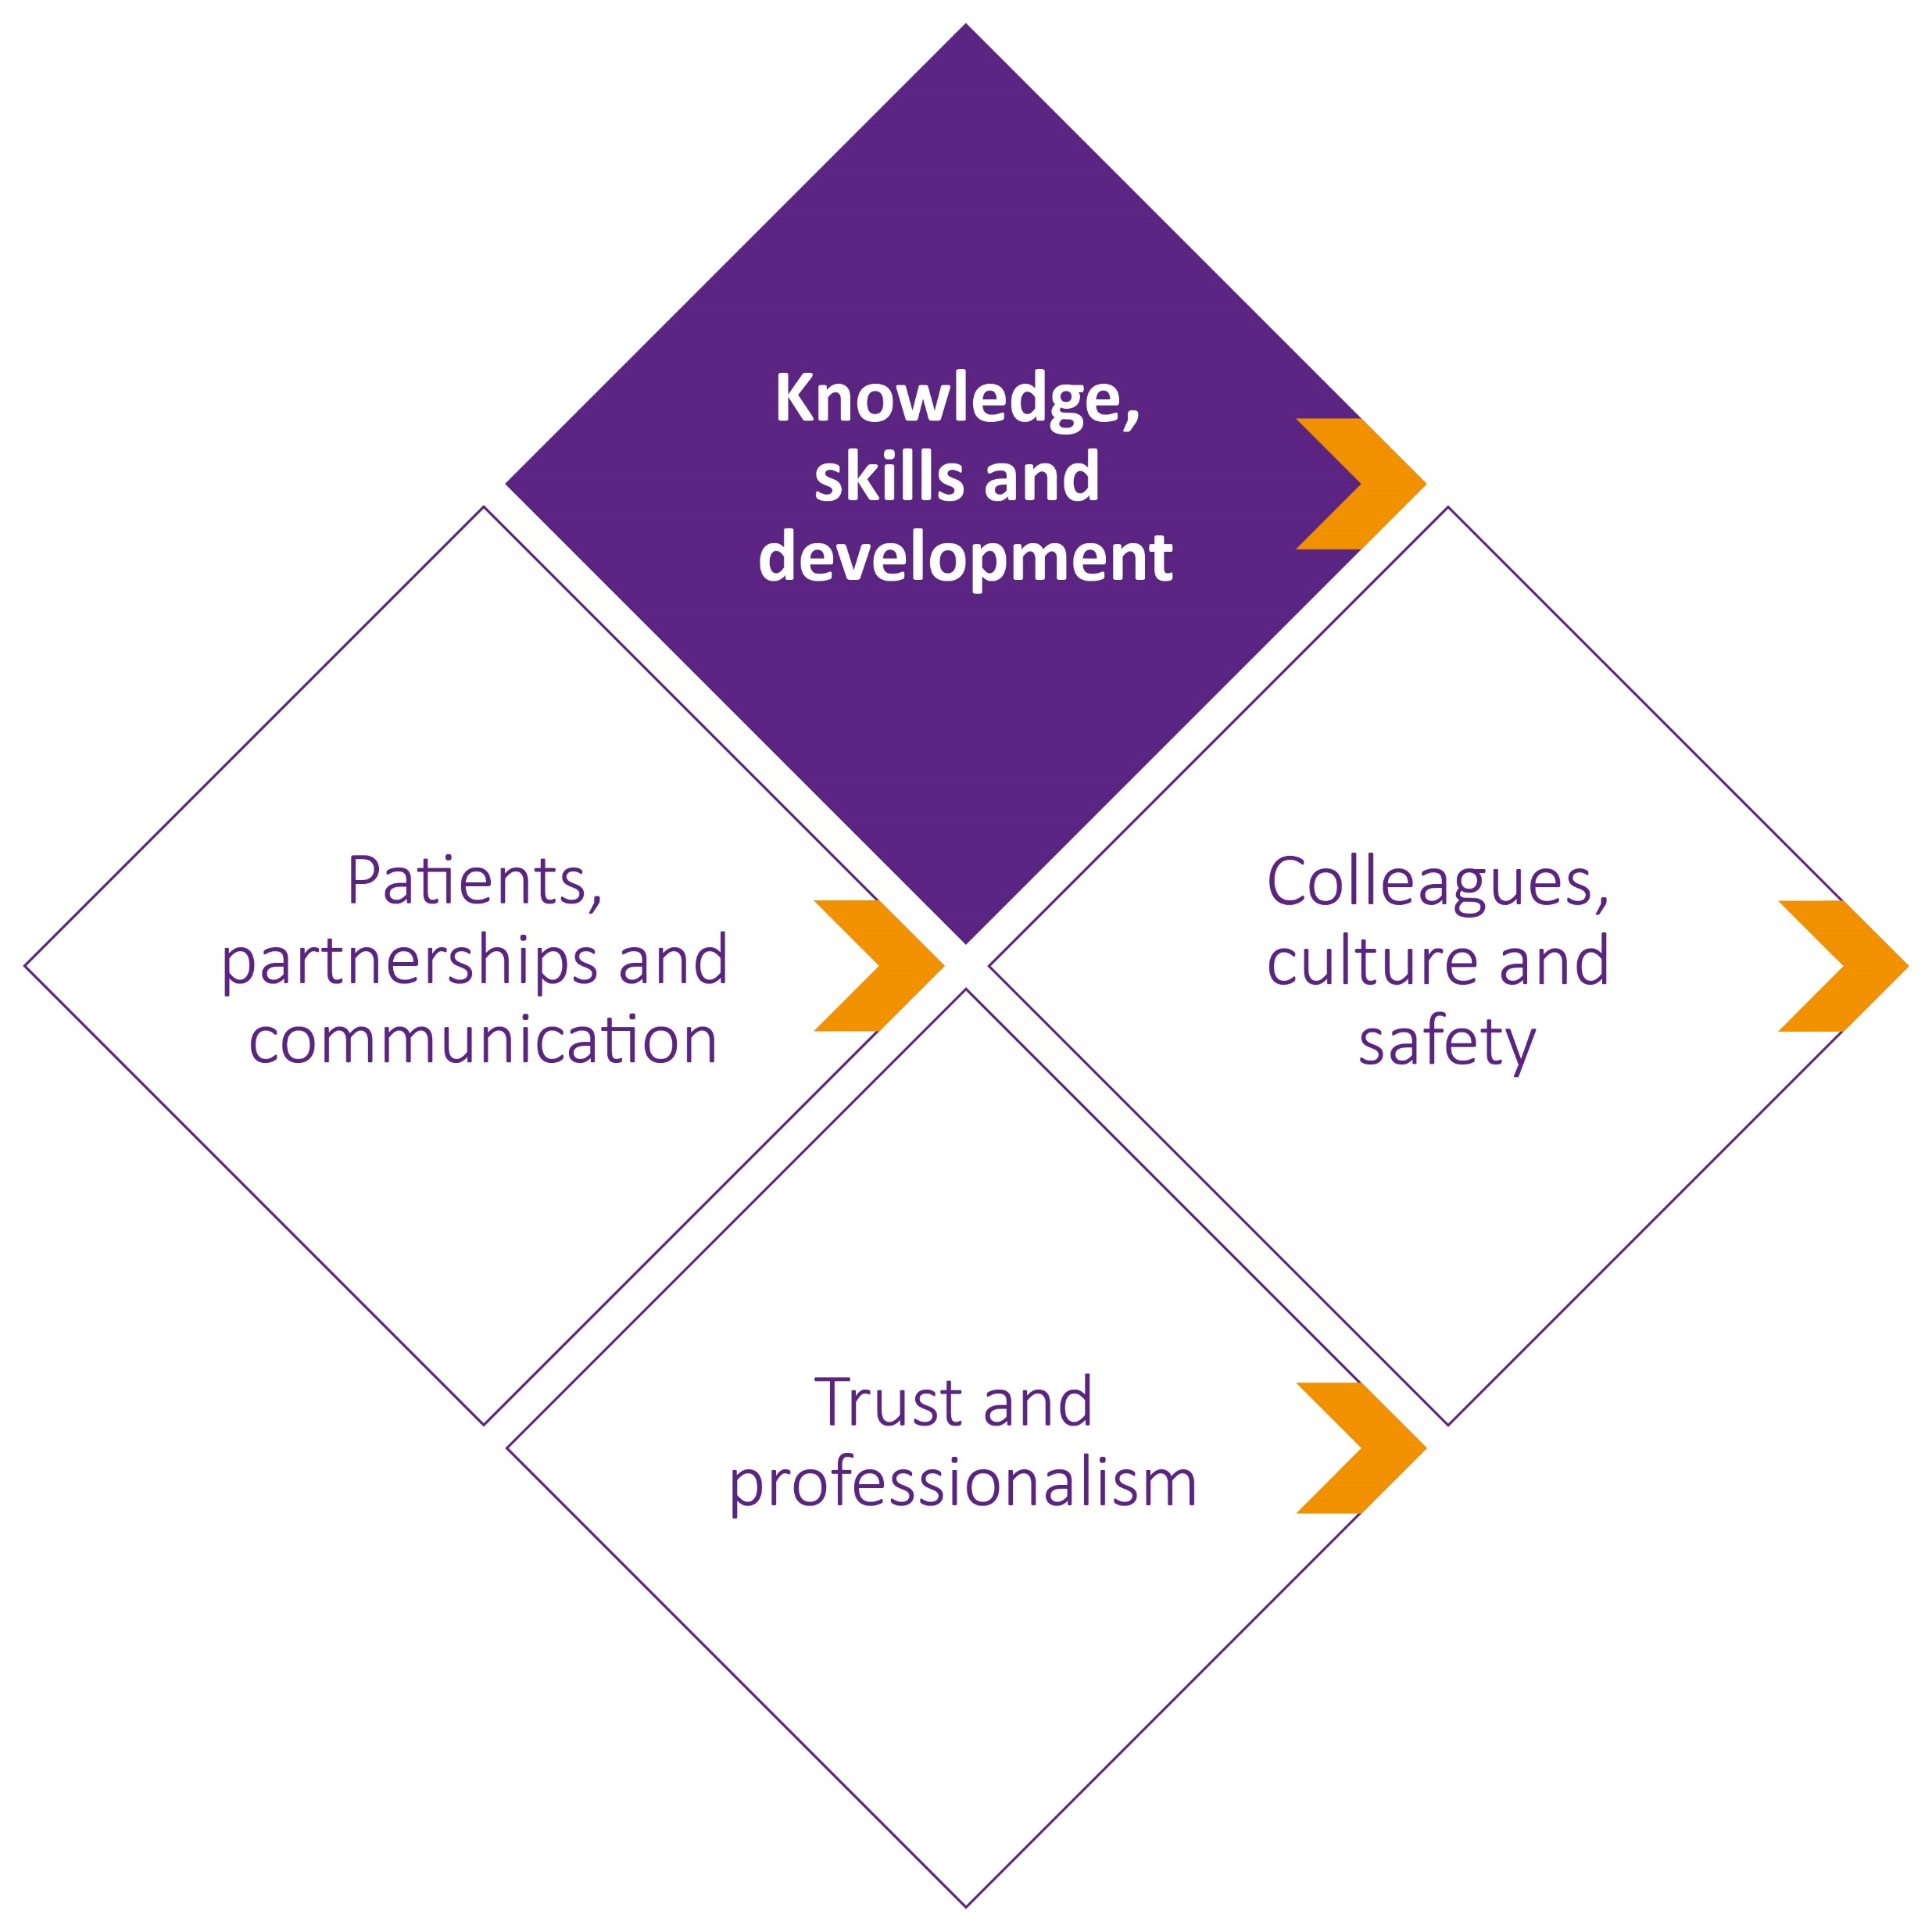
Fairness
Remote consultations
Making sustainable decisions
Research

Slide 16
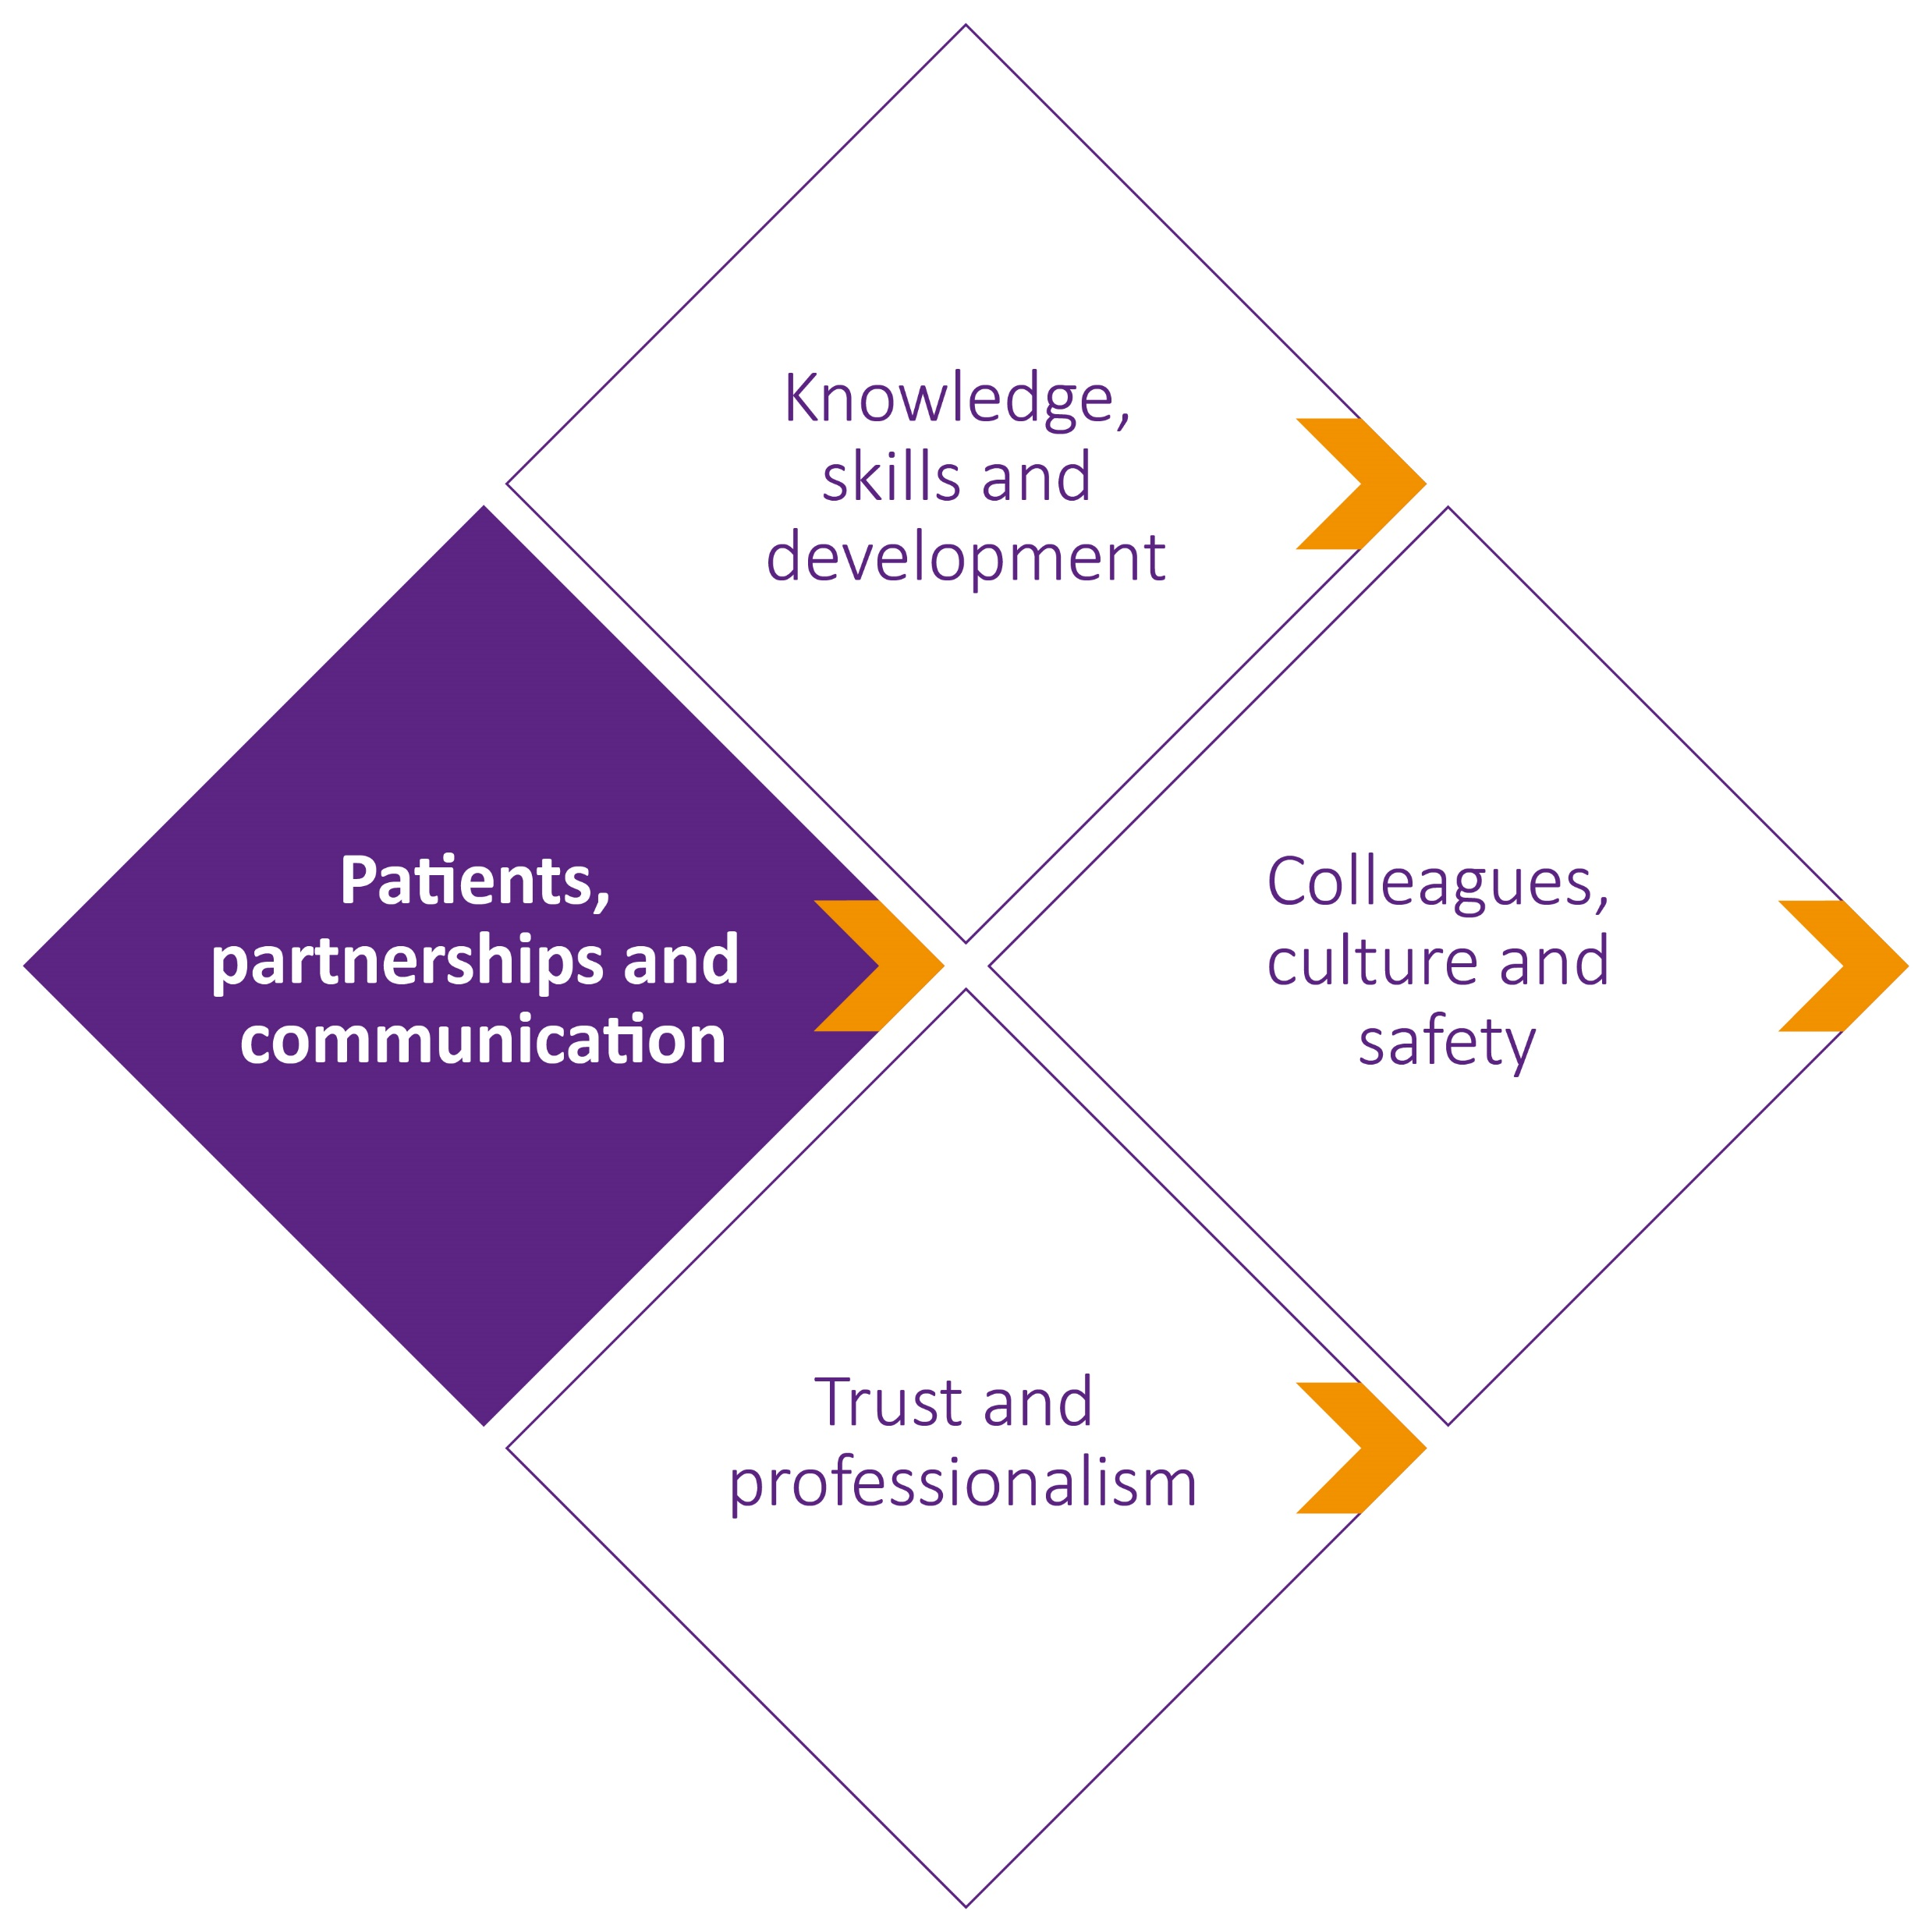
Treating patients with kindness, courtesy and respect
Partnership working
Meeting communication needs
Safeguarding

Slide 17
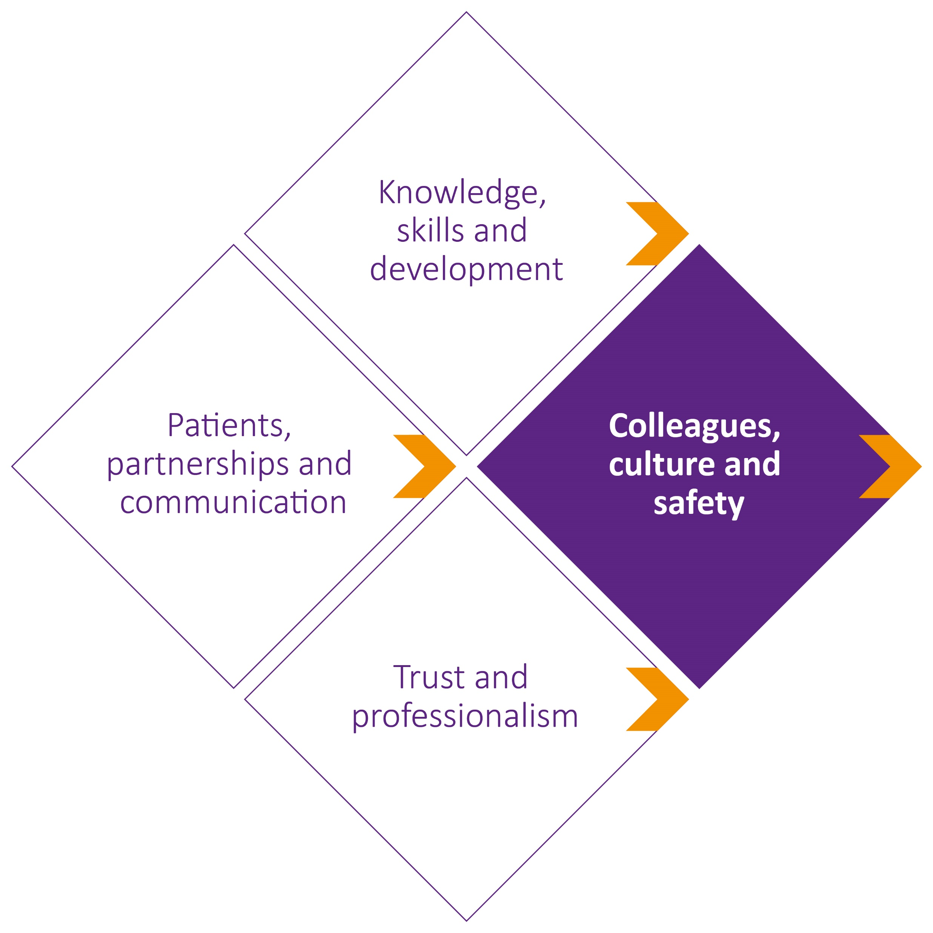
Contributing to a positive environment
Tackling discrimination
Team working and delegation
Leadership

Slide 18
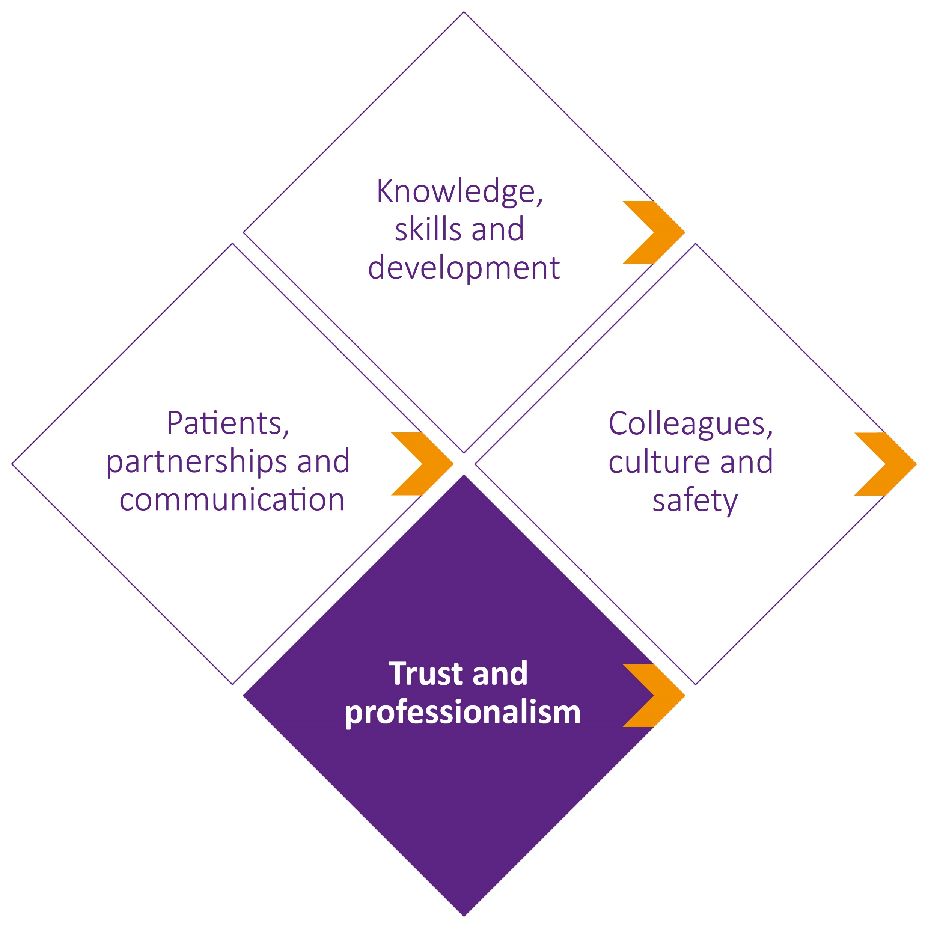
Maintaining professional boundaries
Communicating as a professional
Managing conflicts of interest
Acting with honesty and integrity

Slide 19
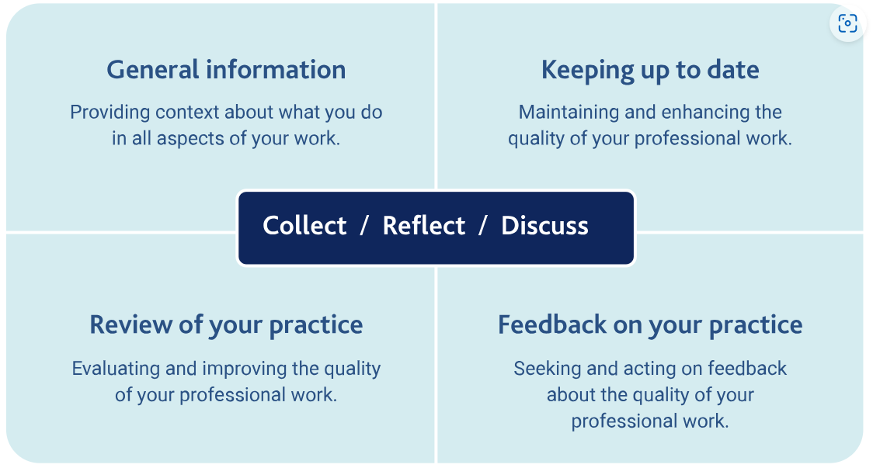
Supporting Information to bring to Appraisal

Slide 20
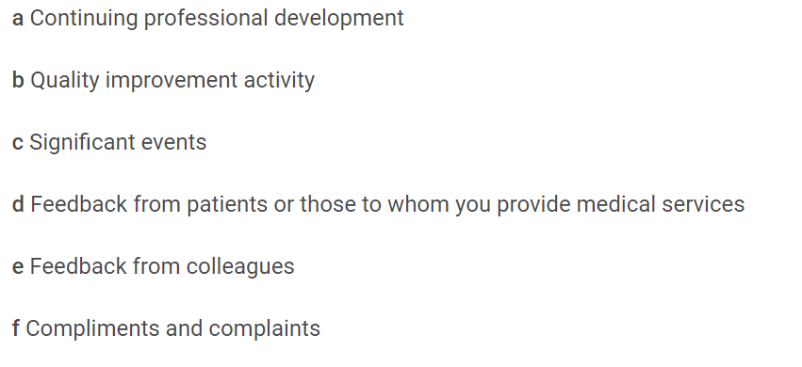
Supporting info that must be provided
Supporting information for appraisal and revalidation - GMC (gmc-uk.org)

Slide 21
Quick question:
How do you feel about the new version of Good medical practice?
Positive that the updates seem to be relevant to current practice and will help my work
I want to read in more detail before I form a view
Not sure it will make much difference
Concerned that there are some important elements missing

Slide 22
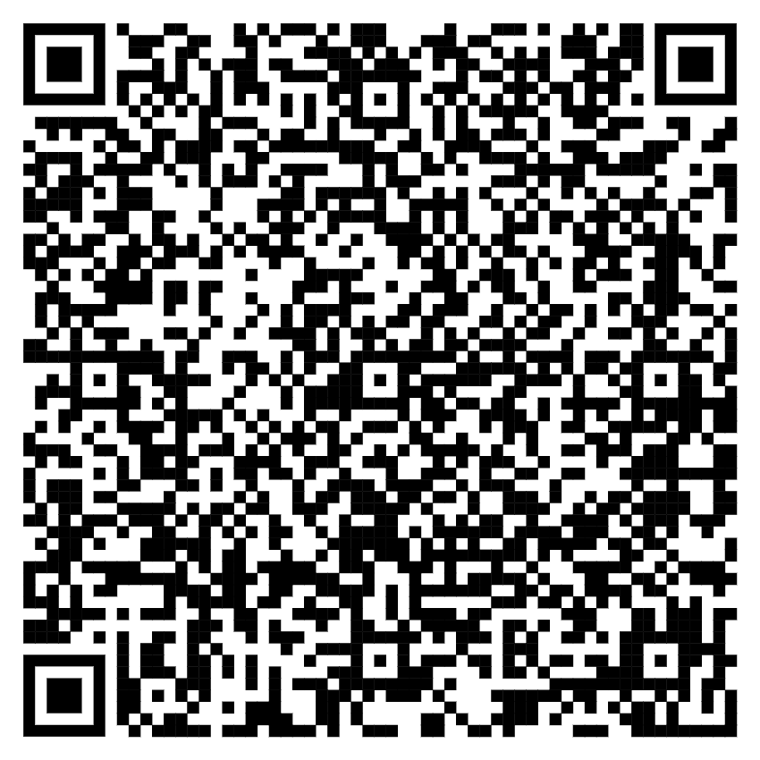
Good medical practice 2024 - GMC (gmc-uk.org)

