Slide 1
Scottish Medical Appraisers Conference
2024/2025
Challenging Appraisal Situations
Dr Barbara Chandler
NHS Highland
Appraisal Lead (Secondary Care)
Dr Jo Rose
NHS Borders and NHS Lothian
Deputy Appraisal Lead (Primary Care)

Slide 2
“During your appraisals (Annual Review of Competence Progression for doctors in training), you will use supporting information to demonstrate that you are continuing to meet the principles and values set out in Good Medical Practice.”

Slide 3
GMC supporting information principles
General information
Providing context about what you do
in all aspects of your work
Keeping up-to-date
Maintaining and enhancing the
quality of your professional work
Collect | Reflect | Discuss
Review of your practice
Evaluating and improving the quality of your professional work
Feedback on your practice
Seeking and acting on feedback about
the quality of your professional work

Slide 4
Continuing Professional Development
Reviewed Complaints & Compliments
Quality Improvement Activity
Whole practice annual appraisal based on GMP
Patient feedback
Significant Events (or serious incidents)
Colleague feedback

Slide 5
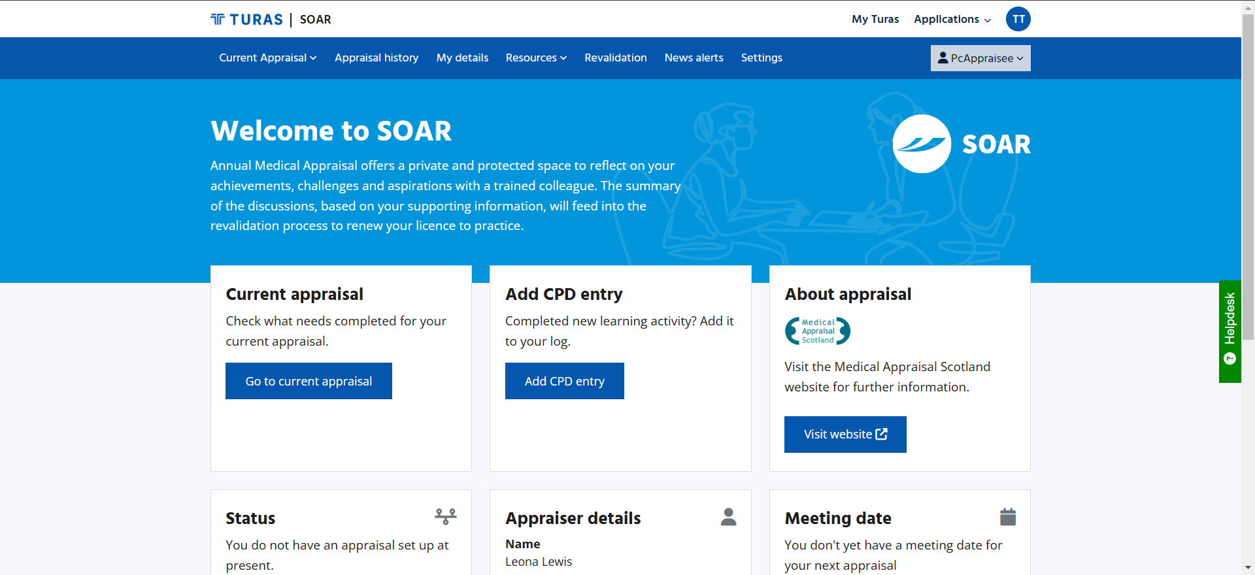

Slide 7
Pre-appraisal challenges
Making contact
Agreeing a date
Submitting material in a timely manner
First time offender
Habitual offender
Impossible

Slide 8
Appraisal challenges
Submitted material
Too much material
Too little material
Virtually no material
Missing key elements
No reflection
Emotions
Very stressed about an issue
Attitude
Doesn’t agree with process
Talks about dissatisfaction with system
Refuses to engage
Health
Evidence of worrying low mood
Possible addiction problem

Slide 9
Post appraisal challenges
Failure to agree Form 4
Concern for wellbeing of appraisee

Slide 10
Specific Situations
New to appraisal
IMG
New specialty doctor or Consultant
Clinical Fellows
Returning after maternity leave or long sick leave
Low volume work
Doctors approaching end of main career / considering retirement in next year or two

Slide 11
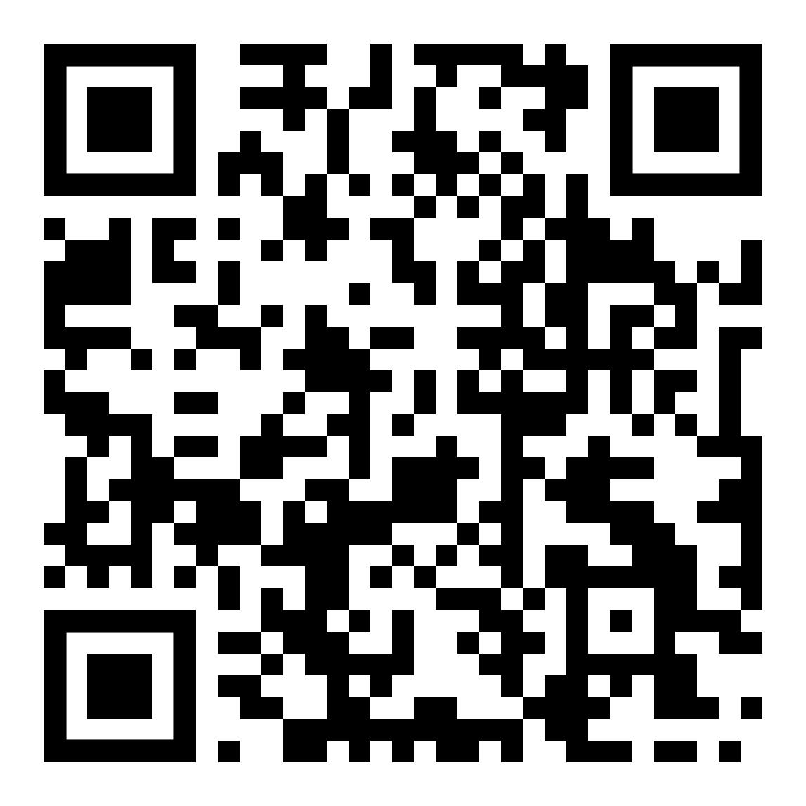
Breakout instructions (for all scenarios)
https://www.appraisal.nes.scot.nhs.uk/s/confinfo/cas/
3 Breakout sessions
15-20 minutes each
Discuss questions
For Q&A, use separate Questback (from link)
Notes:
Jo/Barbara to introduce scenario 1

Slide 12
Scenario 1
Senior clinician approaching retirement, never engaged well with appraisal
Very little submitted material
Confrontational and “grumpy” attitude
Approaching retirement within the next 6 months
Planning to do some clinics and teaching post retirement

Slide 13
How could you challenge their understanding of the purpose of revalidation and of appraisal?
How would you explain the GMC requirements to retain a License to practice post-retirement.
What could you do to engage them to support their post-retirement plans?
Would you consider seeing them again in 6 months for a mid-point review to ensure they are on track? What could that meeting look like?
Can you share (anonymised please) any similar scenarios for the group to discuss? What worked well for you and what would you do differently another time?

Slide 14
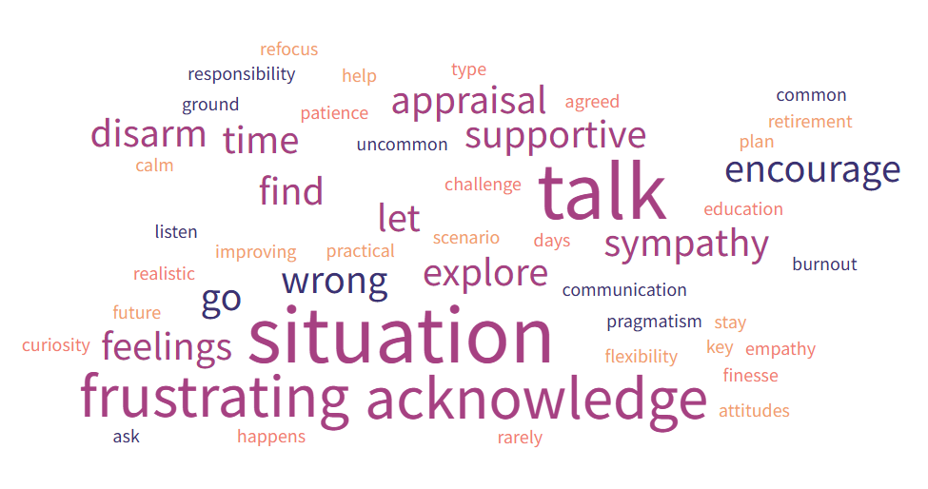

Slide 15
Scenario 2
Experienced busy clinician, mid-point career
Serious complaint which has escalated
Initially about a failed treatment of an elderly relative, but now also about attitude
Previous MSF included comments about abrupt attitude at times especially if stressed

Slide 16
What is going on here in the doctor’s mind?
What level of insight do they have into their behaviour and responses to colleagues and patients?
How can you help this doctor reflect on their approach and reduce risk of future confrontations? How can you challenge without being collusive? How could you link back to their previous MSF?
How would you document this in the Form 4?
Can you share (anonymised please) any similar scenarios for the group to discuss? What worked well for you and what would you do differently another time?

Slide 17
Scenario 3
Young colleague, CCT a couple of years ago, working 3 days a week.
Sketchy paperwork submitted in advance and been slow responding to email.
Last year they submitted a lot of information.
This year there is almost nothing, and the free-text in the appraisal forms indicated that they’ve had some personal stress and are finding work hard too.

Slide 18
What is your priority in this appraisal? What is your role?
What supports do you have locally that you could signpost to?
How would your approach differ depending on how well you establish that they’re coping? What would you do if they seem to be depressed?
Can you share (anonymised please) any similar scenarios for the group to discuss? What worked well for you and what would you do differently another time?

Slide 19
