Slide 1
A Neurodiversity Affirming Approach to Appraisal
Jill Jones and Fiona Young

Slide 2
A Neurodiversity Affirming Approach to Appraisal
Language
Why has language become so important?
Taking a strengths based, affirming approach
ND Umbrella
Appraisal in a ND affirming way
What might this look like?

Slide 3
Language – why is it so important?
How language drives change
Pace of change
Always an individual choice
What do we mean when we talk about:
Neurodiversity
Neurodivergent
Neurodiversity affirming
Prof Sue Fletcher-Watson
Differences, not deficit

Slide 4
Neurodivergence umbrella

Slide 5
Moving away from deficits-based models

Slide 6
Inequality
Physical health
Mental health
Death by suicide
Quality of life
Education and employment
Criminal justice and related settings

Slide 7
A note about women and girls
Prevalence?
Presentation
Masking / camouflage

Slide 8
Rising awareness
Social media
Role models / celebrities
Increasing requests for diagnostic assessment
Importance of neurodiversity affirming practice across all services

Slide 10
What is Neurodiversity affirming practice?
Understanding
Recognition
Acceptance
Support

Slide 11
Valuing and celebrating ND in the population and the workforce
Strengths
Benefits
Outcomes

Slide 12
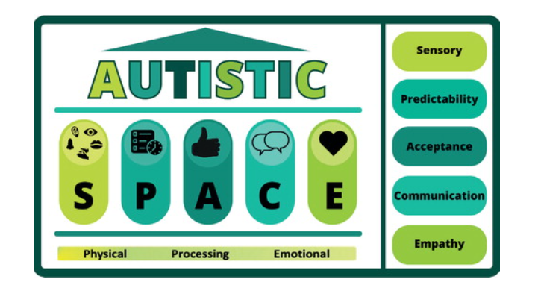
Neurodiversity Affirming Practice
Doherty M, McCowan S, Shaw SC. Autistic SPACE: a novel framework for meeting the needs of autistic people in healthcare settings. Br J Hosp Med (Lond). 2023 Apr 2;84(4):1-9. doi: 10.12968/hmed.2023.0006. Epub 2023 Apr 17. PMID: 37127416

Slide 13
ND Affirming Appraisal
Getting to know the person
Consider how colleague feedback can work
Organisations and professional bodies

Slide 14
Over to you
What easy steps could you take now to make your appraisals more ND affirming?

Slide 15
Supporting Neurodevelopmentally Informed Practice – Improving Inequality
Changing landscape and workforce needs
Ambition that all practice should be ND informed
Theory into practice
How?
Listening to experience
Listening to the workforce and what they need
Paying attention to what evidence is available from research and science

Slide 16
NES training opportunities
Turas page
Specific training opportunities
Related to key priorities, with the goal of reducing inequality
Awareness, recognition, assessment and diagnosis
Person centred supports and intervention
Live, online or face to face

