Slide 1
Scottish Medical Appraisers Conference
28 April 2022
Feedback in Medical Appraisal
Dr Christiane Shrimpton
NES APGD for Appraisal and Revalidation
Dr Mimi Cogliano
NHS Borders and Lothian - Deputy Primary Care Appraisal Lead

Slide 2
What we will cover
What feedback is for
Colleague feedback
Patient feedback
How to approach feedback in appraisals
Group discussion

Slide 3
Role of feedback
Patient experience
View of people you work with
Identify areas of strength and development
Develop greater insight and self-awareness
Opportunities for improvement
Evaluate impact of changes you have made
Notes:
From the GMC guidance:
PSQ: The purpose of reflecting on feedback from your patients is to help you to understand their experience of your practice. Patients have a unique perspective and their feedback can help you to identify areas of strength or opportunities for improvement. It can help you develop greater insight and self-awareness and challenge assumptions.
MSF: To understand how the range of people you work with view your practice.
To help you identify areas of strength and development, and highlight changes you could make to improve the care or services you provide.
To evaluate whether changes you have made to your practice in light of earlier feedback have had a positive impact.

Slide 4
Formal and informal feedback
Colleague feedback
Feedback in specific roles
Appraiser; Trainer; Lead
Patient feedback
Appraiser giving feedback on supporting information submitted and readiness for revalidation

Slide 5
Colleague Feedback (MSF)
How has the appraisee chosen the respondents?
Colleagues across full range of practice?
Multi disciplinary?
Self-assessment and reflection on results
Notes:
Consider how feedback in specific roles fits in best

Slide 6
Feedback tools for colleague feedback
WASP (SOAR link)
Appraiser feedback report (SOAR)
Leadership specific tools
Project Lift
Turas Health and Social Care 360
FMLM
NHS Leadership Academy
Trainer feedback

Slide 7
Scottish Medical Appraisers Conference
28 April 2022
Patient feedback (PSQ) 2022
Where do we go from here? A Lothian pilot....
Dr Mimi Cogliano
NHS Borders and Lothian - Deputy Primary Care Appraisal Lead
Notes:
Thank you Christiane. I am Mimi Cogliano….. I’d like to take you on a whistle stop tour of a PSQ pilot we are developing in NHS Lothian…..

Slide 8
Let us know
What do you feel is the greatest challenge to patient feedback?
Notes:
First, however, I would like to find out from YOU ALL, what you feel are the greatest challenges to patient feedback just now?
Help us build a picture, either by single words or a sentence.
If you want to just have a think about it, just minimise the box and the word cloud poll will stay open in CHAT. It will be open in CHAT until the end of my talk.

Slide 9
GMC (17/11/2020) ​
“A questionnaire may be an option, but other examples include: structured interviews, focus groups, formal comments cards or a remote feedback tool like an app”​
​
allows doctors to reflect on comments, not only scores or ratings ​
questions asked are short, unambiguous and easy to understand​
minimise bias, anonymous, accessible​
is supported by adequate resource and training for appraisers and appraisees on the process ​
​
Notes:
Almost mid-pandemic the GMC came out with new guidance as to the requirements for patient feedback. They stated that we could continue to use a questionnaire, but other examples included…
They also stated that doctors should reflect on COMMENTS not just numbers
Questions should be short and easy to understand, and of note is that we need to provide resources and training for both appraiser and appraisees
A TALL ORDER INDEED

Slide 10
UNCERTAINTY…..​
Appraisees: ​
What do we use now, instead of the reflective template?​
Looking for specific guidance ​
Appraisers:​
What is “acceptable” feedback, going forward?​
Cannot keep asking Appraiser Leads each time…..​
How do we best facilitate constructive discussions?
Notes:
For us, we felt this created a significant amount of uncertainty….

Slide 11
Issues...
1) CARE or GMC Questionnaire​
Difficult with telephone/video consultations, VERY low return rate, admin burden.​
​
2) Fourteen Fish​
Cost to appraisee/health board, new software, a lot of Q, admin burden, outside provider​
​
3) Qualitative approach/interviews/targeted groups​
Time consuming, will it be up to each appraiser to assess validity? Could potentially add a huge burden to Appraiser Leads for consultations about each one...
Notes:
Looking at the specifics of each option…..

Slide 12
WHAT DO WE WANT FROM A PSQ? ​
Collect helpful feedback to encourage/stimulate reflection and discussion​
Quick and easy to use (for Drs and patients)​
Adaptable (can be amended/changed easily)​
Admin friendly (no added burden)​
Anonymised!​
Accessible to young/old/IT savvy and those without a mobile/computer
“Validated” and following Information Governance (IG) principles
Notes:
To try to tease out where to go….I thought, What do we actually WANT from a PSQ

Slide 13
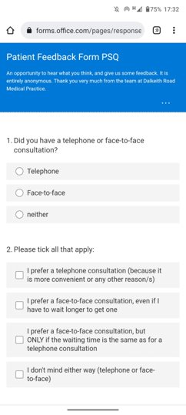
PSQ PILOT ​(“5 CARE ” ​questions)
Telephone or F2F?​
Preferences for Telephone/F2F​
Making you feel at ease?​
Asking Q and letting you talk?​
Listening and understanding?​
Explaining things?​
Making a plan?​
“Stars” – positive comments?​
“Wishes” – what can we improve on? ​
Notes:
So, I went back to the CARE questionnaire, and used the shortened version with 5 Q
I also wanted to know….
And I was VERY keen to get comments as feedback too
Then I created an anonymous questionnaire in MICROSOFT Forms – which is hosted in my safe and secure NHS Lothian O365 account.

Slide 14
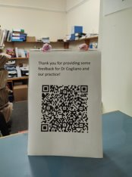
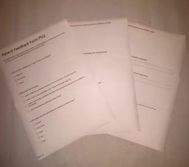
How to collect data?
SMS (or email) QR code Paper copy
Notes:
How did I get patients to engage? I consented patients over the phone, then sent them an SMS with a link
For F2F – I printed a QR code for my receptionist to point to after the consultation
Paper copy for those who preferred, house calls, or had no smart phone

Slide 15
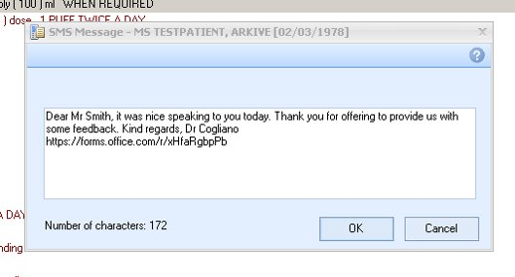
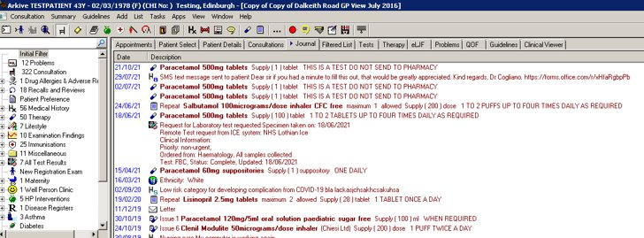
SMS function within GP Vision software (similar with MJOG)
Becomes part of record (“Journal”)
Notes:
In most GP software, there is a direct, individual SMS function. In Vision, it also becomes part of the record.

Slide 16
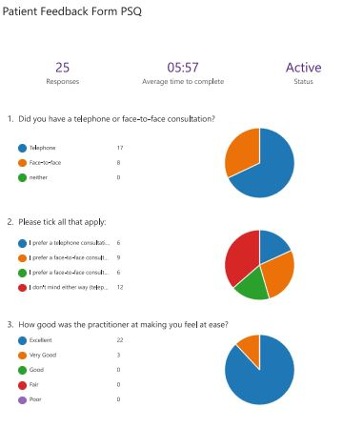
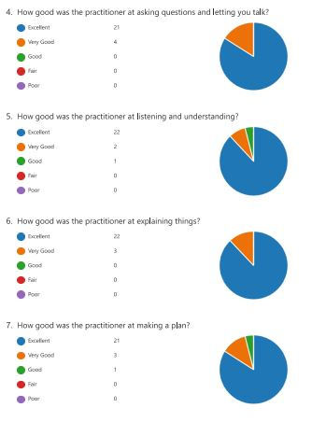
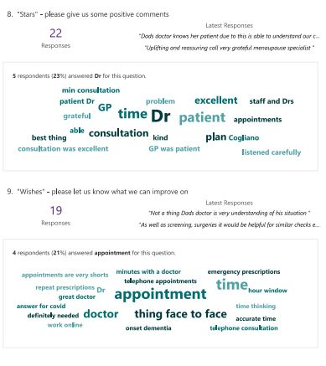
Results
(5 CARE questions - PSQ)
Notes:
The results end up in YOUR own, personal NHS O365 account. No one has to collate or enter anything. You can view the results in a nice pie chart/numerical form, or download as an excel spreadsheet. The comments were particularly great – 22 took the time to enter something! (often the meaty part of the PSQ discussion)

Slide 17
Results - SUMMARY
(5 CARE questions - PSQ)
Anonymised​
Secure Microsoft Forms/Office 365 NHS account​
Numbers/percentages/pie chart
Encourages comments
Easily downloaded & shared with appraiser
Paper forms can be entered by hand
Feel free to email with any Q or if you want to try it out!
mimi.cogliano@nhslothian.scot.nhs.uk
Notes:
So, in summary. This 5 CARE Question PSQ, provided an anonymised, secure way to get a PSQ – covering the RANGE of my practice (including all the phone consultations we do now). It also encourages comments, can easily be adapted to each practitioner/practice.
Feel free to email me if you want to learn more, or even try it out.
At the moment, I am working with NHSLOTHIAN Digital Health to develop a possibly even easier option (for both primary and secondary care doctor). The doctor logs in to send an SMS on the go (from their mobile/tablet/laptop) to the questionnaire, which is hosted on a secure platform, where only they can access the results. Perhaps I can tell you more about this at next year’s conference. Or if you are just very interested, and want to be kept in the loop, feel free to ping me an email. (CLOSE THE POLL, back to you Christiane)

Slide 18
Context
Specialty specific or generic tool?
If it includes any comparisons – who was included in the benchmarking group?
Scope of work
Type of consultations

Slide 19
Impact depends on
Facilitation
Inclusion of narrative comments
Sources being seen as knowledgeable and credible
Agreement with feedback
Emotional reaction
Reflection

Slide 20
What issues may you come across?
High scores and lowest percentiles
Mismatch self-assessment and scores
No or few comments
MSF respondents do not include relevant staff
Unexpected critical comments the doctor is very upset about

Slide 21
How to give feedback
Invite self-appraisal and reflection
Use factual examples
Be specific rather than generic
Be challenging but not judgemental
Talk about ‘intention and impression’
Help the appraisee find ways to resolve issues
Notes:
Principles apply equally to other areas of appraisal: Too much or too little supporting information
SI appears irrelevant
Appraisees have not recognised what they are doing that would be suitable as SI
Not on track for revalidation
....

Slide 22
BREAK-OUT GROUPS
In groups of 4
Think of a challenging feedback situation you have had
What skills did you use that helped or hindered the discussion?
How did your own bias influence the appraisal discussion?

Slide 23
Your thoughts
Please write down some themes (or key words) you discussed in your break out discussion

Slide 24
Questions

Slide 25
Reflect on
What will you take forward into your own practice as an appraiser?

