Slide 1
Improving Appraisal Conversations
Egan Skilled Helper Model
Welcome
Notes:
Increasing emphasis on appraisal as a formative experience that is valued by the appraisee
It is perhaps the only opportunity in the year when the appraisee can have protected time in a safe space to reflect and explore.
Appraisal covers both the reflecting back on what has gone and looking forward in the new PDP to what lies ahead.
Coaching or mentoring skills can be highly effective in supporting people in this situation.
Connor and Pokora; Coaching and Mentoring at Work: developing effective practice
A module is now included in the new appraiser training and has been really popular.
These skills are useful not just within appraisal but in personal decision making; informally supporting others and even in clinical situations

Slide 2
Today…
… is an introductory taster session
… is NOT training appraisers to coach
… is experiential / practical
“a meaningful issue that you are happy to explore in this context”
Notes:
The aim of today’s session is to give you a taster of what mentoring and coaching is. We are NOT re-training appraisers to be coaches, we are simply introducing you to a different communications tool, a different framework of discussion that you might find useful in appraisal conversations.
Once we have introduced you to the model, we will offer you an opportunity to put that into practice in this safe environment. And we have asked you to bring a meaningful issue to use in this context. So the timetable for today… (NEXT SLIDE)

Slide 3
Time | Session
09:00 | Welcome and introductions
09:10 | What is mentoring / coaching
09:55 | BREAK
10:05 | Egan model
10:45 | BREAK
10:55 | Practice skills
12:20 | Q&A
12:30 | End

Slide 4
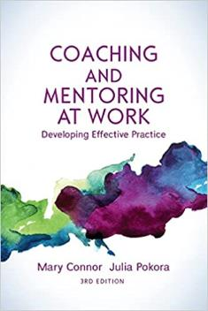
“Coaching and mentoring are often used alongside appraisal, training and development, and performance review”
Connor, Pokora 2017

Slide 5

What are the skills used in mentoring and coaching?
Is the approach relevant/useful in appraisal?
Does it produce an outcome that the appraisee would value?
Descriptions
Models
Skills

Slide 6

What dilemmas do appraisees bring?
I have one really difficult colleague and I can’t change things
How do I take forward my great idea?
How do I cope with a complaint
My week is just too overloaded and I don’t know how to change it
Colleagues don’t understand my vision for the department
Should I go part time
Should I take on a new role
Should I give up a current role
This Photo by Unknown Author is licensed under CC BY-NC
Notes:
[In large group discussion] invite participants to suggest some dilemmas appraisees bring – 4 to 5 minutes and then click to bring up examples on screen.

Slide 7

Coaching and Mentoring
“…the learning relationship is at the heart of change”
Connor and Pokora 2002
“…learning relationships which help people to take charge of their own development, to release their potential and to achieve results which they value”
Connor and Pokora 2017
“…the goal of helping is not to solve problems but to help the person manage them more effectively or even transcend them by taking advantage of new possibilities in life,”
Egan 2002
Notes:
The terms coaching and mentoring certainly within an NHS context mean very similar things and its not a good use of time to focus on the precise definition
What we are talking about is a learning experience in which the underpinning assumption/understanding is that people have the ability to change and to make choices to achieve a goal or objective that they value and is meaningful to them. This process can be supported by someone walking alongside and having a conversation in which the questions and prompts are focussed on encouraging exploration by the individual mentee and allowing them to work out and learn for themselves how to move forward
HOW DOES THIS APPLY TO WHAT WE DO IN APPRAISAL?

Slide 8
Mentoring / Coaching: What it is…
A learning relationship
Applies core principles of respect, empathy, genuiness
Mentee/Client sets the agenda
Mentor/Coach facilitates insight and releases potential
Mentor/Coach enables exploration leading to change and a valued outcome
Formative, encouraging self reflection
Focused on the individual
Structured
Ethical practice
Notes:
Rogers Person Centred Counselling empathy, genuineness, unconditional positive regard
Resonates with what we are doing as appraisers

Slide 9

Mentoring / Coaching: What it is not…
Teaching
Telling
Advising
Instructing
Counselling
Comfortable chat

Slide 10
Listening Phillips and Pokora 2004
Diagnostic Listening
Active Listening
Listen to facts
      Selective listening
      Filtering irrelevancies
Solve the problem
Listen to person
      Actively attending
      Nothing is irrelevant
      Reflecting
      Hearing
      What is not being said
      How does it feel
      Where is the energy
Responding
Notes:
Rest of talk is on the Egan model at its heart is about listening skills; which are also a key part of appraising

Slide 11

Personal experience
Can you identify any such learning relationships that have helped
  Within work
  Outside work
  What were the qualities of the person providing that support
Are there times when you would have valued this type of support ?
Have you ever had this support as appraisee or provided it as appraiser?
Notes:
Facilitator to decide (depending on group size): Breakout or group chat; or have a think and put into chat

Slide 12

The skilled helper model Egan 2010
What’s going on?
  Story; new perspectives; value point
What is my preferred picture?
  Possibilities; change agenda a specific goal; commitment
What is the way forward?
  How do I get what I need / want;
  best fit strategies; PLAN
Notes:
One model applicable to coaching and mentoring

Slide 13
Improving Appraisal Conversations
Egan Skilled Helper Model
Video clip 1
Discussion of skills used

Slide 14
Time | Session
09:00 | Welcome and introductions
09:10 | What is mentoring / coaching
09:55 | BREAK
10:05 | Egan model
10:45 | BREAK
10:55 | Practice skills
12:20 | Q&A
12:30 | End

Slide 15
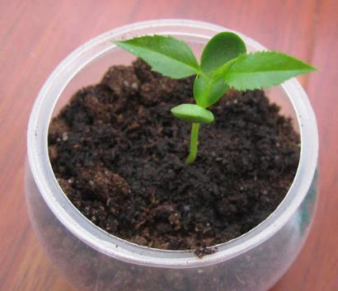
“Within the seeds of wild ideas may be the germ of a realistic possibility”
Connor and Pokora 2002

Slide 16

STAGE 1
STAGE 2
STAGE 3
Current picture
What’s going on?
Preferred picture
What do I need / want?
The way forward
How do I get there?
Story
Possibilities
Possible strategies
New perspectives
Change agenda
Best fit strategies
Value
Commitment
Plan
Action Leading to Valued Outcomes
How do I make it all happen?
Notes:
Overview of the three stages of the Egan model.

Slide 17
Stage 1: Current picture (What’s going on?)
Reflecting
Non-verbal
Story
What do you want to talk about?
What’s going on?
Paraphrasing
Open questions
Summarising
Silence
New perspectives
What might you have missed?
What’s really going on?
Echo key words
Blind spots
Other perspectives
Value
Value
What is most valuable to work on? What is meaningful for you?
Tell me…
Because…
I wonder…
Notes:
Skills of mentor: help mentee move from the overall story to exploring any new perspectives and then focusing and prioritising something to work on
what’s most important?
what’s most urgent?
what do you have energy for?
what’s a manageable bit?
a word to describe this?
“out of all of this, is there something
we can take forward to work on?”

Slide 18
Stage 2: Preferred picture (What do I need/want?)
Imagine
Ideal future
Possibilities
Imagination
What are you doing
What are you feeling
Fun, fast, lots of ideas
What? Not How?
Change agenda
Shape a change agenda
Permission to dream
What is most important
What do you have energy for
What might get in the way
Commitment
Test commitment
How will you feel when you achieve this goal
SMART Goal
Scale 1-10, how committed are you
Notes:
Moving from ought to want
Create a SMART goal
Wanted & Valued Goal; Owned by Mentee; In the mentee’s control
Test commitment – benefits and costs for individual and for their organisation; what has stopped you until now; how will you feel when you achieve this; how committed on 1-10 scale are you; is it worth the effort
“Is there a goal emerging from your ideas which would take you one step of the way towards your ideal?”

Slide 19
Improving Appraisal Conversations
Egan Skilled Helper Model
Video clip 2
Brainstorming

Slide 20
Stage 3: The way forward (How do I get there?)
Ideas to achieve goal
Possible strategies
What will help you get what you want
Creative, fun, no limits
Best fit strategies
Which options make sense
Fits with core values
Time frame, working back
Plan
What is the action plan and how do you start
Final test of commitment
Notes:
By this point in a coaching mentoring session – client has imagined a range of strategies to achieve their goal; decided which of these fit best with their values and resources chosen strategies and developed an action plan. Probably not what you would do in an appraisal session but there are times when this can be done very quickly
People Who can help ?
Places Where should we do this ?
Organisations Where do they do this well?
Ideas/models/ examples
Precedents Who’s done it before? Past experiences
best fit with your core values? fit your resources; most likely to be successful? fewest unwanted consequences?

Slide 21
Time | Session
09:00 | Welcome and introductions
09:10 | What is mentoring / coaching
09:55 | BREAK
10:05 | Egan model
10:45 | BREAK
10:55 | Practice skills
12:20 | Q&A
12:30 | End

Slide 22
What dilemmas do appraisees bring?
I have one really difficult colleague and I can’t change things
How do I take forward my great idea?
How do I cope with a complaint
My week is just too overloaded and I don’t know how to change it
Colleagues don’t understand my vision for the department
Should I go part time
Should I take on a new role
Should I give up a current role
This Photo by Unknown Author is licensed under CC BY-NC

Slide 23


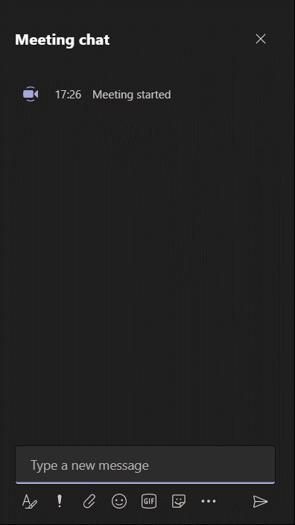




BREAK-OUT GROUPS
Skills Practice
Trios with a facilitator;
25 mins each role (15+10)
Duos with a facilitator;
37 mins each role (22+15)
Appraisee/Mentee
Appraiser/Mentor
Observer and timekeeper
Facilitator
Based on the Egan model

Slide 24
Improving Appraisal Conversations
Egan Skilled Helper Model
Summary of introductory session
Skills used in coaching/mentoring
Model of coaching/mentoring
Tools to aid exploration and facilitate learning and change

Slide 25

Final Questions

Slide 26
References
Connor & Pokora 2017 Coaching and Mentoring at Work: developing effective practice.
Egan G 2013 The Skilled Helper

