Slide 1
Appraisal in cycle 2: a ‘soft re-boot’ Maurice Conlon Clinical Advisor, Professional StandardsTeam, NHS England
Scottish Medical Appraisers Conference
10 May 2019

Slide 2
The context
Revalidation second cycle well under way
Appraisal and revalidation processes well embedded
Prevailing issues: resources, workload, morale, service transformation
Paterson, Bawa-Garba, Gosport.
Pearson Report, perceived ‘burden’, ‘skewed focus’

Slide 3
As a result
Is it time to shift the focus from refining processes to maximising the benefits of appraisal – a ‘soft re-boot’?

Slide 4
Broadly:
Diminish the mechanics…
…develop the learning

Slide 5
The GMC agree:
Five GMC Priorities:
Make revalidation accessible to the public
Reduce bureaucracy for doctors
Strengthen processes for doctors moving around
Provide a responsible officer for every UK doctor
Measure the effects of revalidation
Taking Revalidation Forward - the Pearson review

Slide 6
This is not about dropping anything or doing anything new:
Purposes of medical appraisal
To demonstrate fitness to practise for revalidation
To plan professional development
To consider personal needs
and
To help doctors and their organisations work together
From Medical Appraisal Guide v4, September 2014

Slide 7
This is not about dropping anything or doing anything new:
Purposes of medical appraisal
To demonstrate fitness to practise for revalidation
To plan professional development
To consider personal needs
and
To help doctors and their organisations work together
From Medical Appraisal Guide v4, September 2014

Slide 8
This is not about dropping anything or doing anything new:
Purposes of medical appraisal
To demonstrate fitness to practise for revalidation
To plan professional development
To consider personal needs
and
To help doctors and their organisations work together
From Medical Appraisal Guide v4, September 2014

Slide 9
This is not about dropping anything or doing anything new:
Purposes of medical appraisal
To demonstrate fitness to practise for revalidation
To plan professional development
To consider personal needs
and
To help doctors and their organisations work together
From Medical Appraisal Guide v4, September 2014

Slide 10
The shift in emphasis is not a change in substance, but will help engagement and quality

Slide 11
What attributes do we want in our doctors?
Good, safe, professional, resilient, confident, personable, articulate, compassionate, principled, practical, healthy, diligent, knowledgeable, capable, self-aware, kind doctors
That is how it leads to better patient care.

Slide 12
Put another way…
Safe | Effective | Well-led | Responsive | Caring
Safe Resilient Practical Healthy | Good Confident Diligent Personable Articulate Knowledgeable | Professional Principled | Self-aware | Compassionate kind
Knowledge skills and performance | Safety and quality | Teamwork partnership and communication | Maintaining trust
Good Knowledgeable Capable | Safe Confident Diligent | Personable Articulate | Professional Principled Self-aware Compassionate Kind

Slide 13
A rule of thumb:
A good appraisal is felt to be useful by the doctor.

Slide 14
Can we move from:
‘I need to postpone my appraisal because I am under a lot of pressure’

Slide 15
To:
‘I need my appraisal because I am under a lot of pressure’

Slide 16
My appraisal was excellent …relaxed but organised … challenging yet supportive, suggesting … ideas re how to resolve some of the problems I presented.
I have done the formal feedback, but feel special praise needed here.
Thanks.’
GP, 2017

Slide 17
‘My most noteworthy appraisal was with an appraiser who gave me permission to do things differently and step off a treadmill of my own creation. To my eternal gratitude.’
GP, 2018

Slide 18
Products to help:
ROAN Information Sheet: Minimising paperwork, maximising benefit
Appraisal Preparation Guide – all doctor/GP

Slide 19
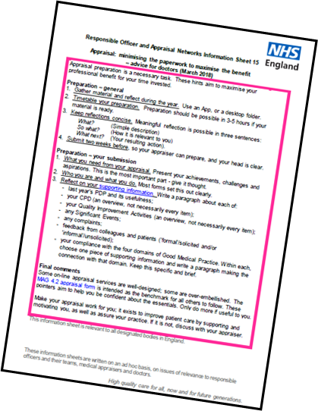
1. ROAN Info Sheet 15: Minimising paperwork, maximising benefit
Preparation strategies, concise reflection, ‘3-5 hours to prepare’
Essentials in the submission
Avoid over-embellished appraisal vehicles
Discuss things if the appraisal does not feel useful.

Slide 20
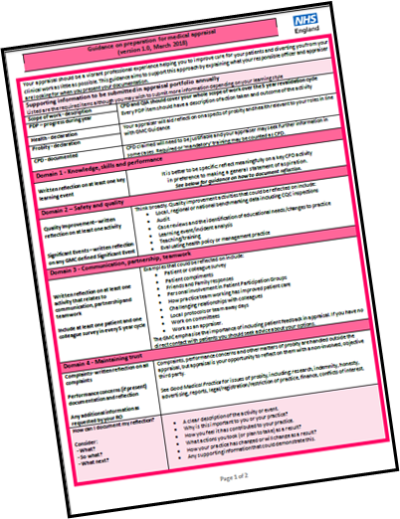
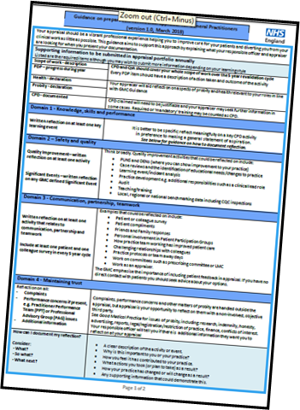
2. Appraisal Preparation Guide
‘All-doctors’ (pink) and ‘GP’ (blue) versions (minimally different in the examples offered only)
A two-side aide-memoire for doctors; helpful for appraisers too
Especially helpful for the reflection on GMP domains: specific reflection on an activity is preferable to general statements of aspiration
A short guide to reflection – especially useful for ‘non-reflecters’ by nature
A helpful glossary for those for whom this is not bread and butter activity.

Slide 21
What is this all making room for?
What are the issues you would find most useful to discuss today?
Achievements, challenges and aspirations
…identify the doctor’s agenda.

Slide 22
Being useful in all directions
First be useful for the doctor
Also be useful for the system
Always be useful for patients

Slide 23
Thoughts:
Does this resonate?
What can we do to advance it if so?

Slide 24
‘My last appraisal has particularly left me with food for thought. It felt appraisal was an individual process for me, about what mattered.’
GP 2018

Slide 25
‘…a very useful reflective exercise on my first year as a consultant.’
2018

Slide 26
‘[The appraiser’s] views were considered and stimulating…’
Foundation Trust doctor, 2018

Slide 27
‘…insightful and helpful appraisal…’
NHS Trust Responsible Officer, 2018

Slide 28
‘I …want to …thank you for your support during my appraisal meetings – I found the whole experience incredibly valuable.’
Responsible Officer, Private Sector, 2017

Slide 29
‘Helpful and enjoyable appraisal – are they allowed to be that?’
NHS Responsible Officer, 2016
What’s your story?
Please tell me: maurice.conlon@nhs.net

